Slide 1
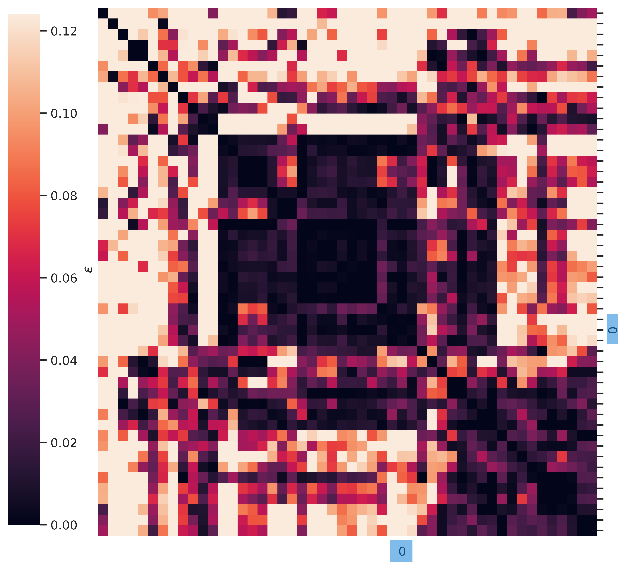
On Linear Mode Connectivity up to Permutation of Hidden Neurons in Neural Networks
When does Model Averaging work?

Slide 2
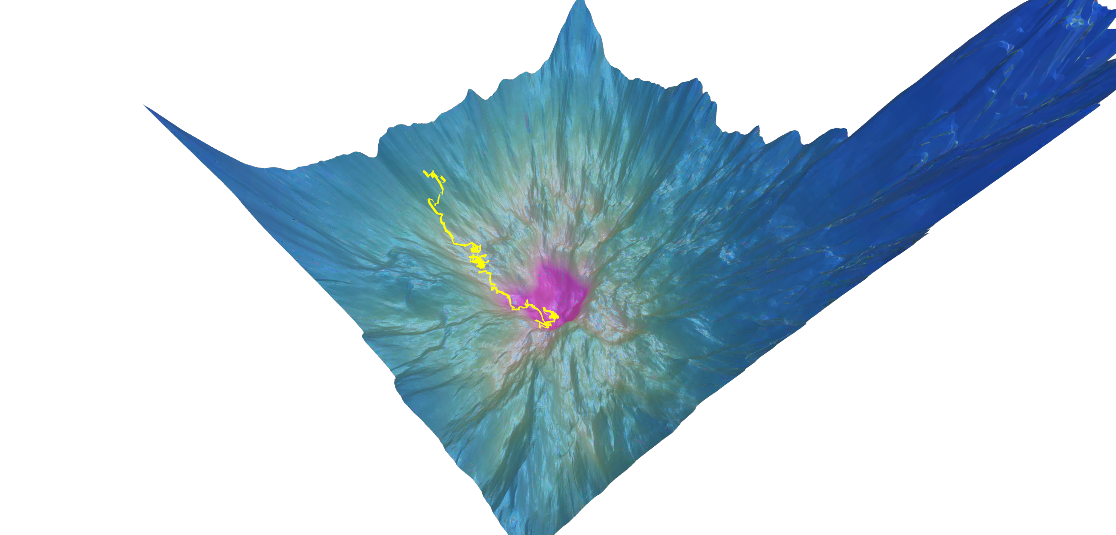
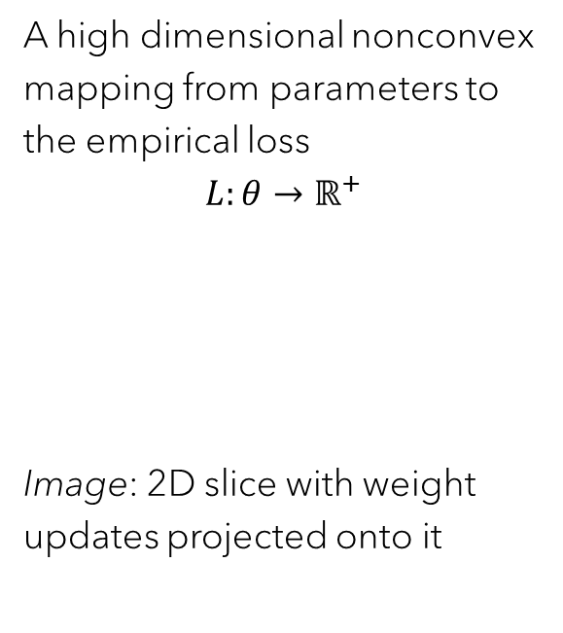
Loss surface of Neural Networks
A high dimensional nonconvex mapping from parameters to the empirical loss
$$L:θ→ℝ^{+}$$
Image: 2D slice with weight updates projected onto it
Source: Loss landscape explorer: Explore real loss landscapes of deep learning optimization processes. https://losslandscape.com/explorer

Slide 3
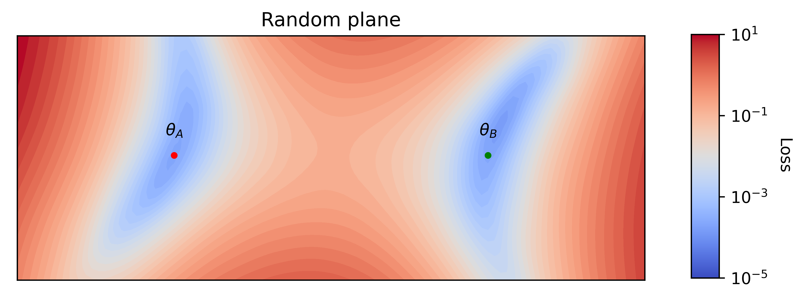
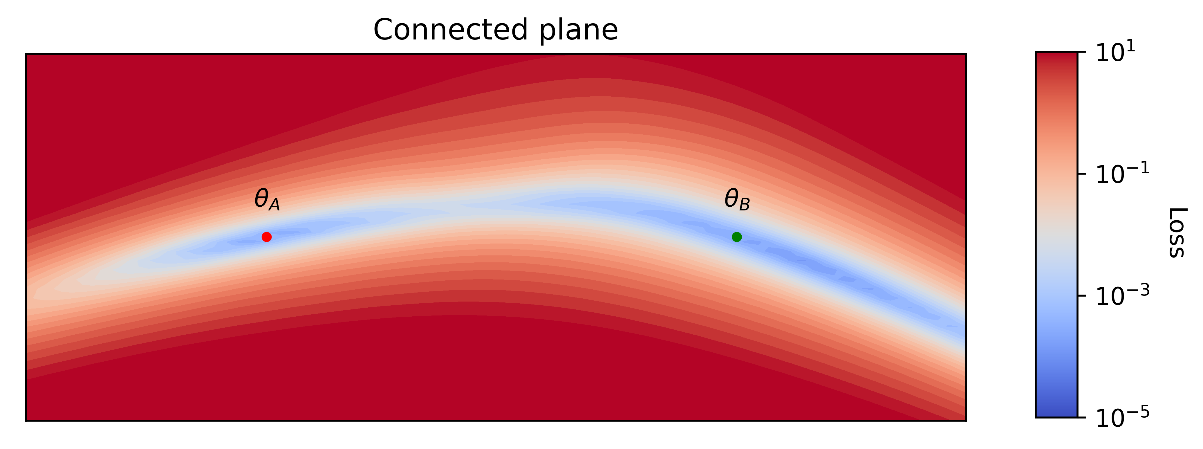
From isolated minima to mode connectivity
Mode connectivity is the phenomenon where solutions obtained through variants of gradient descent are connected by simple curves in the weight space along which the loss remains low

Slide 4
Why is this surprising at all?
It has to do with identifiability

Slide 5
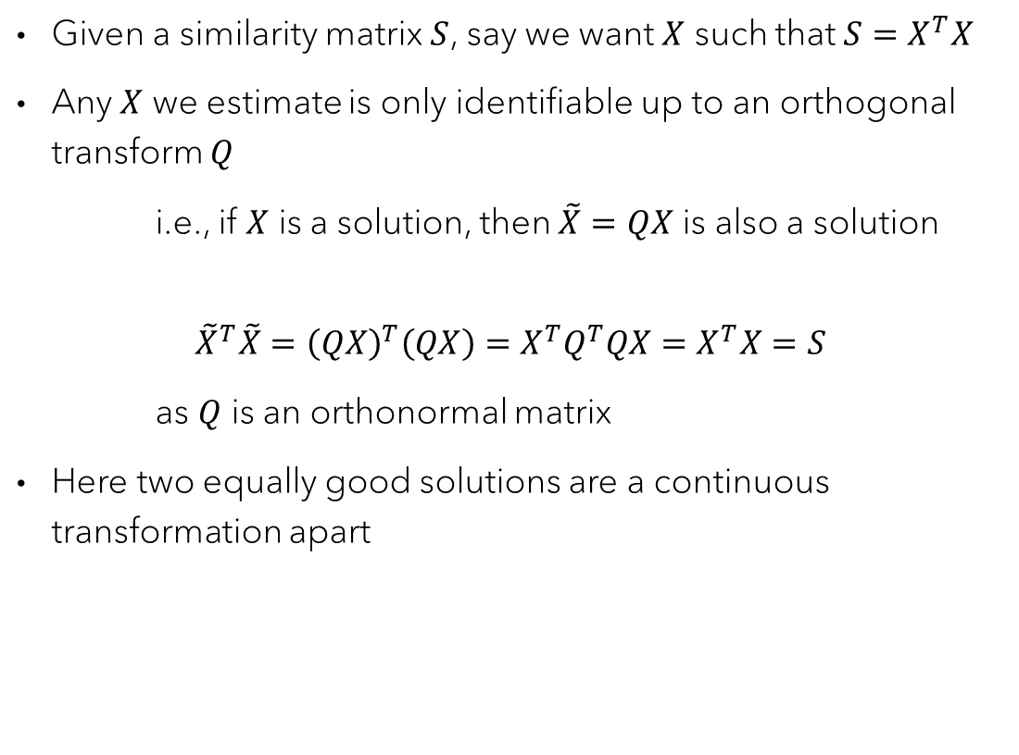
Example 1: Matrix decomposition
Given a similarity matrix $S$, say we want $X$ such that $S=X^{T}X$
Any $X$ we estimate is only identifiable up to an orthogonal transform $Q$
i.e., if $X$ is a solution, then $\tilde{X}=QX$ is also a solution
$${\tilde{X}}^{T}\tilde{X}={\left(QX\right)}^{T}\left(QX\right)=X^{T}Q^{T}QX=X^{T}X=S$$
as $Q$ is an orthonormal matrix
Here two equally good solutions are a continuous transformation apart

Slide 6
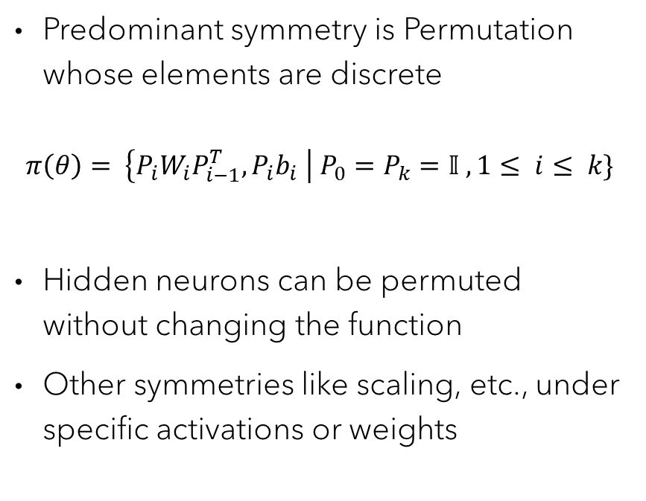
Example 2: Neural Networks
Predominant symmetry is Permutation whose elements are discrete
$$π\left(θ\right)= \left\{P_{i}W_{i}P_{i−1}^{T}, P_{i}b_{i} \right| P_{0}=P_{k}=𝕀 ,1≤ i≤ k\}$$
Hidden neurons can be permuted without changing the function
Other symmetries like scaling, etc., under specific activations or weights

Slide 7
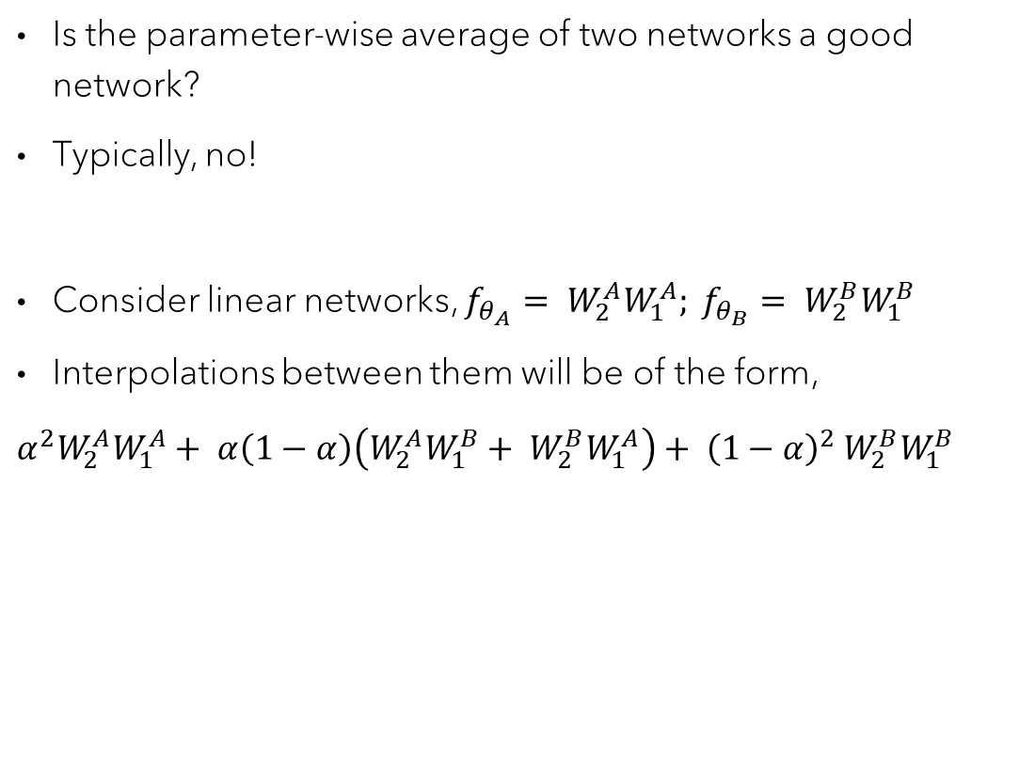
Mode connectivity to linear mode connectivity
Is the parameter-wise average of two networks a good network?
Typically, no!
Consider linear networks, $f_{θ_{A}}= W_{2}^{A}W_{1}^{A}; f_{θ_{B}}= W_{2}^{B}W_{1}^{B}$
Interpolations between them will be of the form,
$α^{2}W_{2}^{A}W_{1}^{A}+ α\left(1−α\right)\left(W_{2}^{A}W_{1}^{B}+ W_{2}^{B}W_{1}^{A}\right)+ {\left(1−α\right)}^{2}$ $W_{2}^{B}W_{1}^{B}$

Slide 8
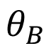
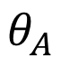
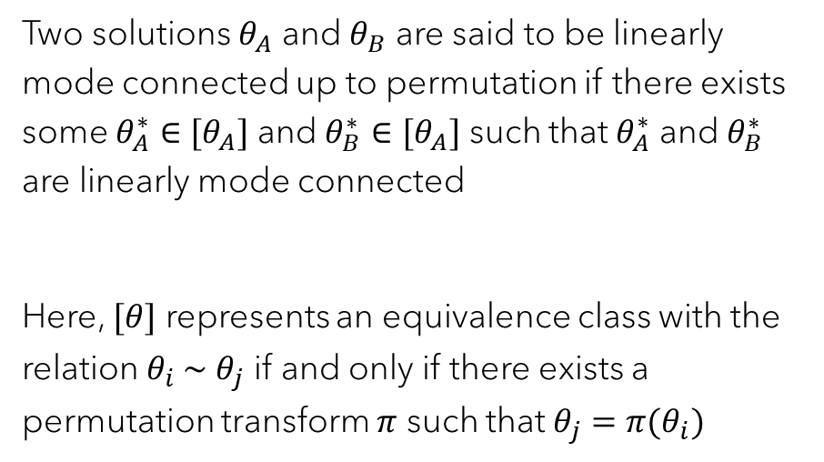
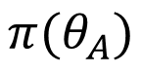
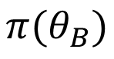
Linear mode connectivity up to permutation
$$θ_{B}$$
$$π(θ_{B})$$
$$π(θ_{A})$$
Two solutions $θ_{A}$ and $θ_{B}$ are said to be linearly mode connected up to permutation if there exists some $θ_{A}^{∗}∈[θ_{A}]$ and $θ_{B}^{∗}∈[θ_{A}]$ such that $θ_{A}^{∗}$ and $θ_{B}^{∗}$ are linearly mode connected
Here, $[θ]$ represents an equivalence class with the relation $θ_{i}$∼ $θ_{j}$ if and only if there exists a permutation transform $π$ such that $θ_{j}=π(θ_{i})$
?
$$θ_{A}$$

Slide 9
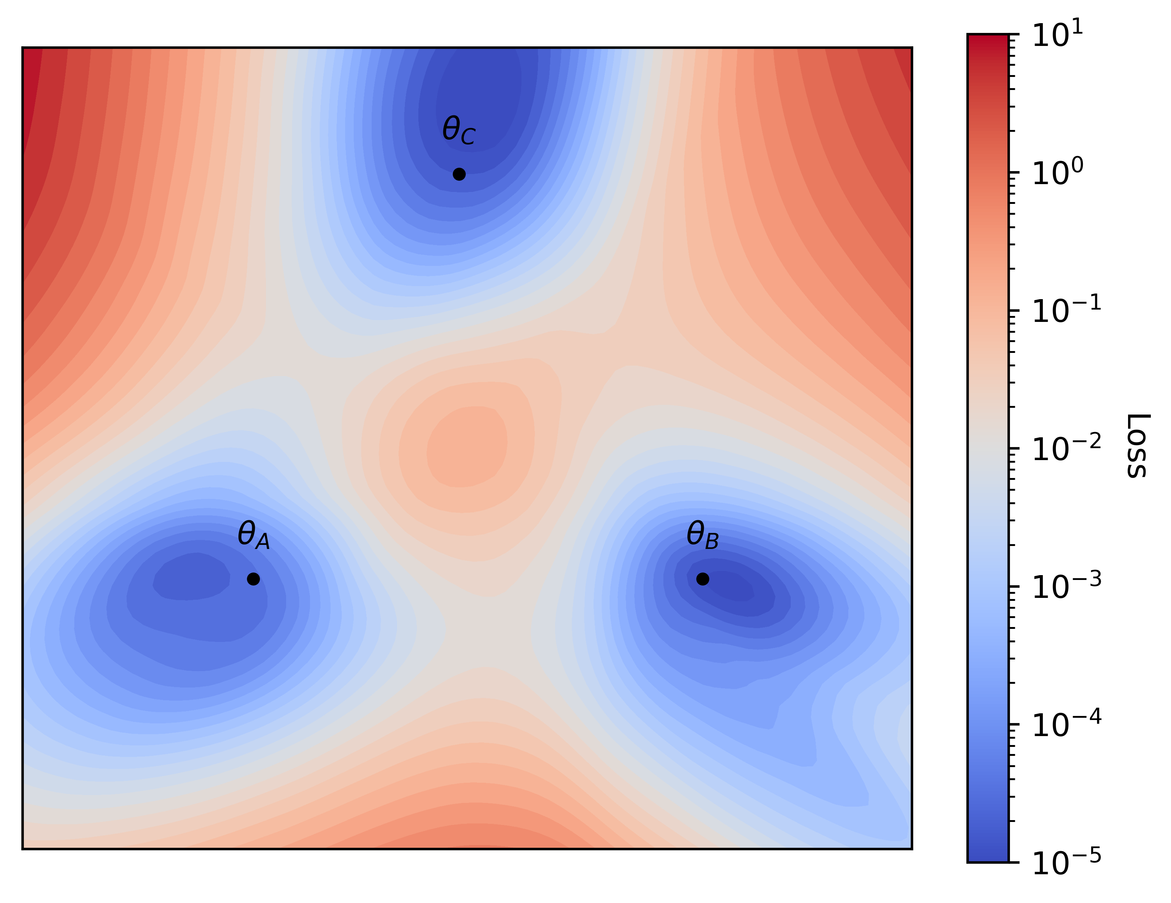
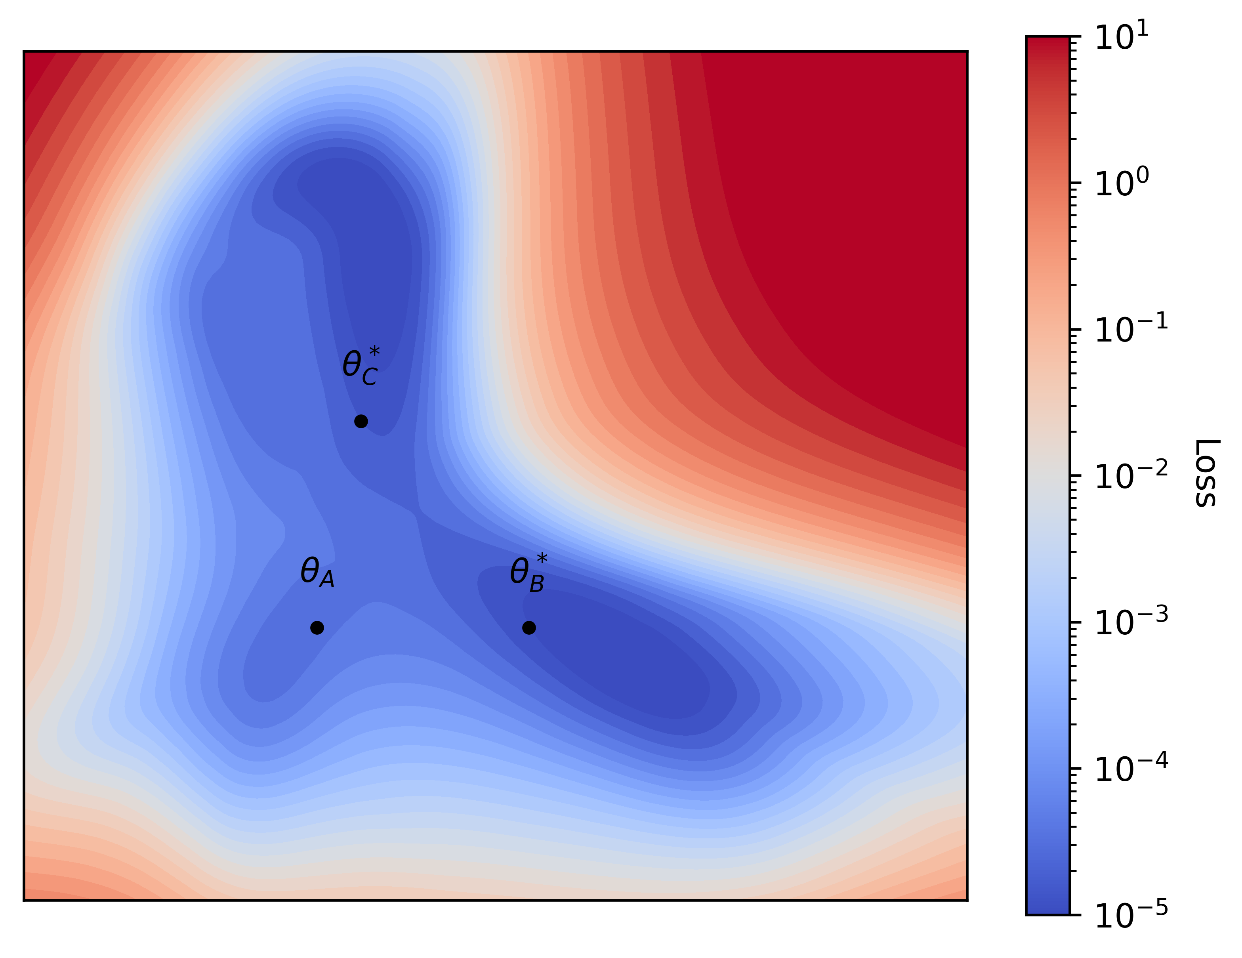
Most trained networks are LMC up to permutation
Loss plane through three trained networks weights
Two networks are reparameterized to be aligned

Slide 10
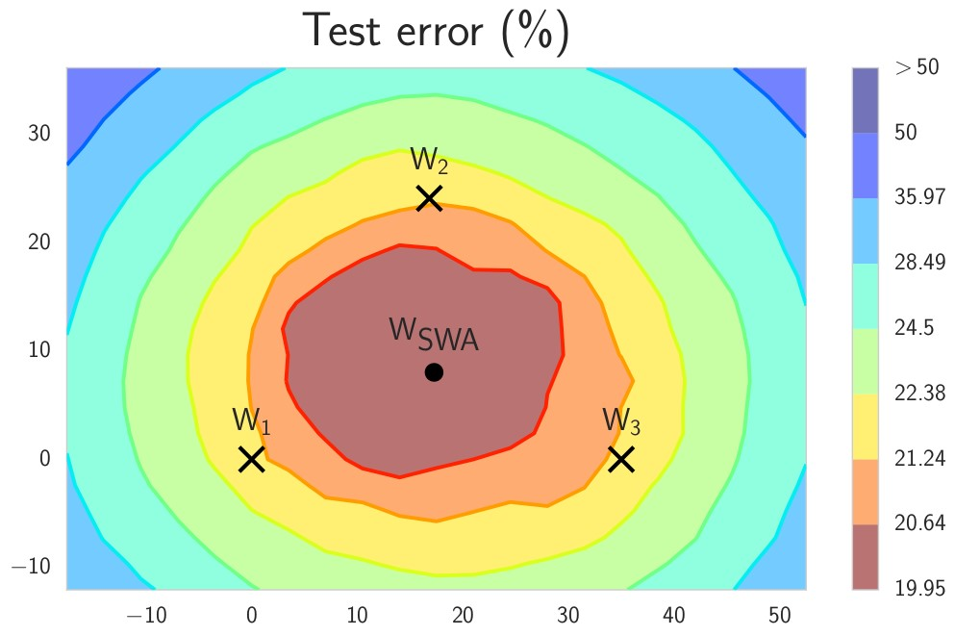
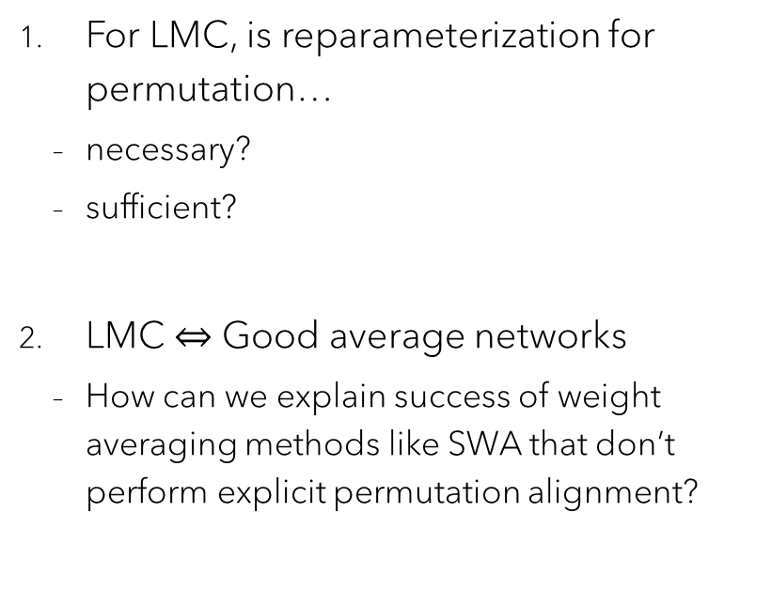
Research questions
For LMC, is reparameterization for permutation…
necessary?
sufficient?
LMC $⇔$ Good average networks
How can we explain success of weight averaging methods like SWA that don’t perform explicit permutation alignment?
Source: Izmailov et al. (2018)

Slide 11
Experiment setup
Architectures:
2-layer fully connected ReLU networks
4-layer fully connected ReLU networks with layernorm
Data:
Moons
MNIST
CIFAR-10

Slide 12
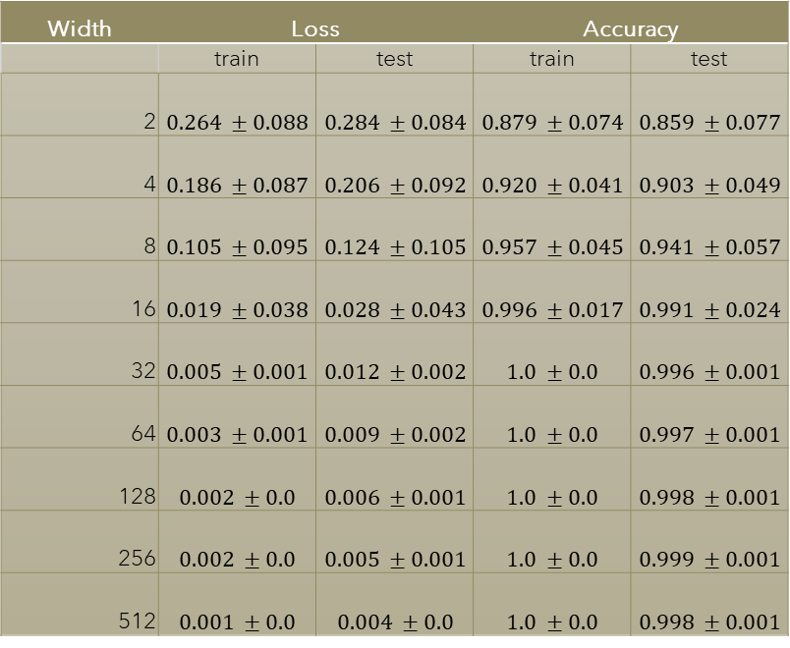
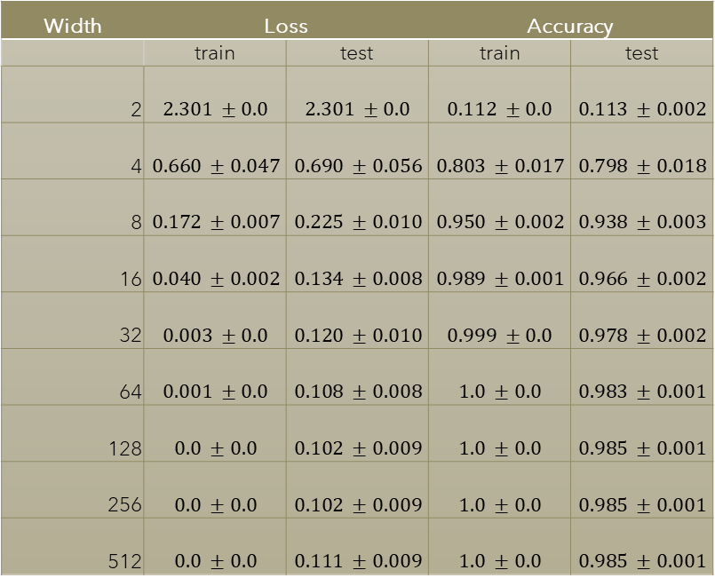
Model zoo: Moons (left) and MNIST (right)
Width | Loss |  | Accuracy
 | train | test | train | test
2 | $$0.264 ±0.088$$ | $$0.284 ±0.084$$ | $$0.879 ±0.074$$ | $$0.859 ±0.077$$
4 | $$0.186 ±0.087$$ | $$0.206 ±0.092$$ | $$0.920 ±0.041$$ | $$0.903 ±0.049$$
8 | $$0.105 ±0.095$$ | $$0.124 ±0.105$$ | $$0.957 ±0.045$$ | $$0.941 ±0.057$$
16 | $$0.019 ±0.038$$ | $$0.028 ±0.043$$ | $$0.996 ±0.017$$ | $$0.991 ±0.024$$
32 | $$0.005 ±0.001$$ | $$0.012 ±0.002$$ | $$1.0 ±0.0$$ | $$0.996 ±0.001$$
64 | $$0.003 ±0.001$$ | $$0.009 ±0.002$$ | $$1.0 ±0.0$$ | $$0.997 ±0.001$$
128 | $$0.002 ±0.0$$ | $$0.006 ±0.001$$ | $$1.0 ±0.0$$ | $$0.998 ±0.001$$
256 | $$0.002 ±0.0$$ | $$0.005 ±0.001$$ | $$1.0 ±0.0$$ | $$0.999 ±0.001$$
512 | $$0.001 ±0.0$$ | $$0.004 ±0.0$$ | $$1.0 ±0.0$$ | $$0.998 ±0.001$$
Width | Loss |  | Accuracy
 | train | test | train | test
2 | $$2.301 ±0.0$$ | $$2.301 ±0.0$$ | $$0.112 ±0.0$$ | $$0.113 ±0.002$$
4 | $$0.660 ±0.047$$ | $$0.690 ±0.056$$ | $$0.803 ±0.017$$ | $$0.798 ±0.018$$
8 | $$0.172 ±0.007$$ | $$0.225 ±0.010$$ | $$0.950 ±0.002$$ | $$0.938 ±0.003$$
16 | $$0.040 ±0.002$$ | $$0.134 ±0.008$$ | $$0.989 ±0.001$$ | $$0.966 ±0.002$$
32 | $$0.003 ±0.0$$ | $$0.120 ±0.010$$ | $$0.999 ±0.0$$ | $$0.978 ±0.002$$
64 | $$0.001 ±0.0$$ | $$0.108 ±0.008$$ | $$1.0 ±0.0$$ | $$0.983 ±0.001$$
128 | $$0.0 ±0.0$$ | $$0.102 ±0.009$$ | $$1.0 ±0.0$$ | $$0.985 ±0.001$$
256 | $$0.0 ±0.0$$ | $$0.102 ±0.009$$ | $$1.0 ±0.0$$ | $$0.985 ±0.001$$
512 | $$0.0 ±0.0$$ | $$0.111 ±0.009$$ | $$1.0 ±0.0$$ | $$0.985 ±0.001$$

Slide 13
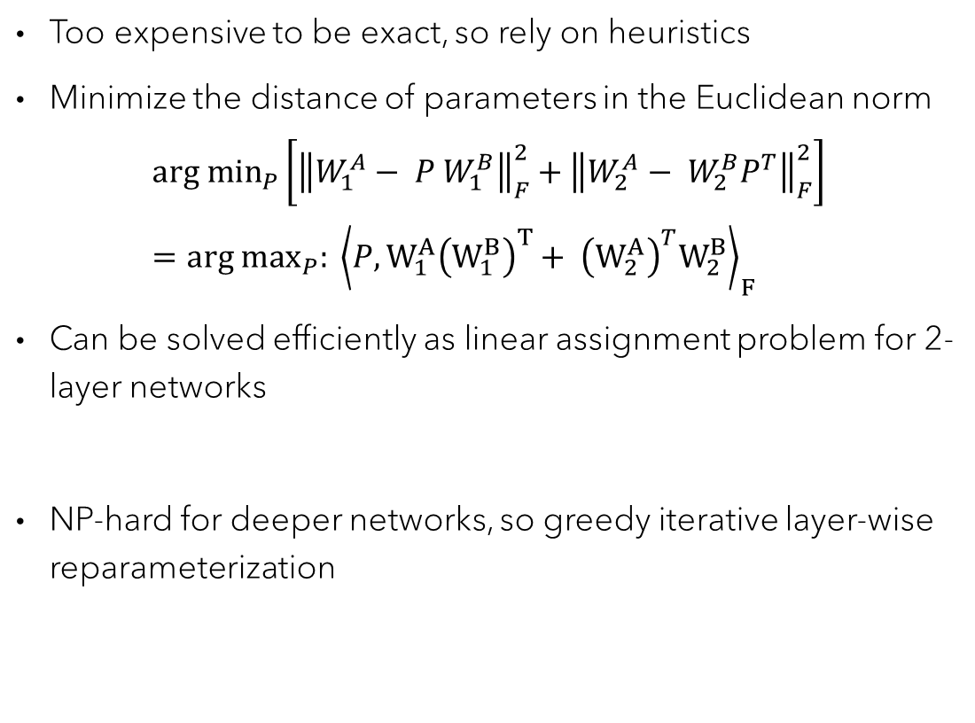
Reparameterization method: Weight matching
Too expensive to be exact, so rely on heuristics
Minimize the distance of parameters in the Euclidean norm
$${arg min}_{P}\left.\left[{\left\|W_{1}^{A}− P W_{1}^{B}\right\|}_{F}^{2}+{\left\|W_{2}^{A}− W_{2}^{B}P^{T}\right\|}_{F}^{2}\right.\right]={arg max}_{P}: {\left\langle P, W_{1}^{A}{\left(W_{1}^{B}\right)}^{T}+ {\left(W_{2}^{A}\right)}^{T}W_{2}^{B}\right\rangle }_{F}$$
Can be solved efficiently as linear assignment problem for 2-layer networks
NP-hard for deeper networks, so greedy iterative layer-wise reparameterization

Slide 14

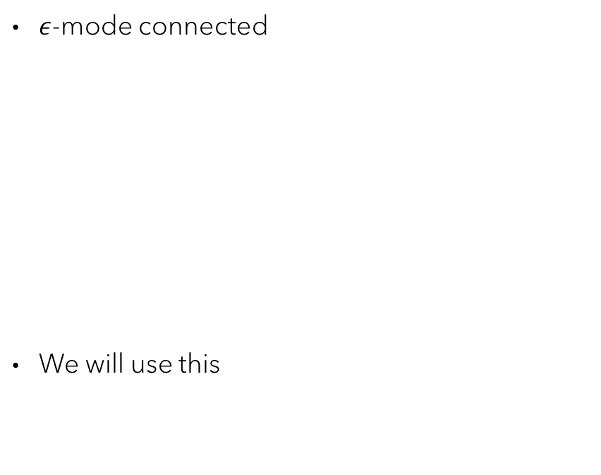
Measure of linear mode connectivity
$ε$-mode connected
We will use this
Loss barrier
Loss
Loss
$$ε$$
B

Slide 15
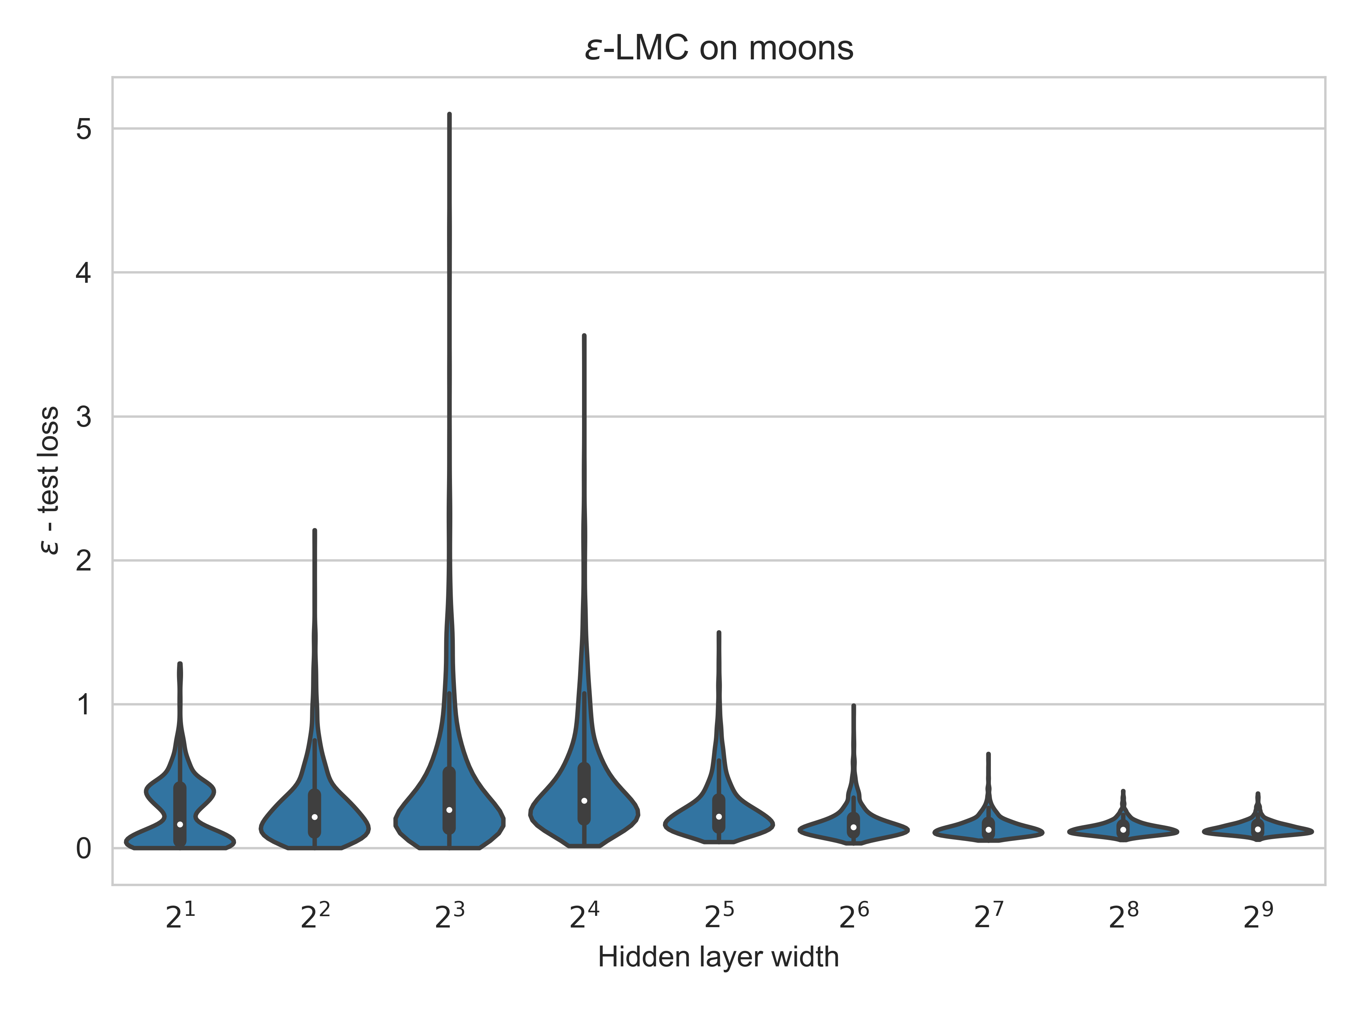
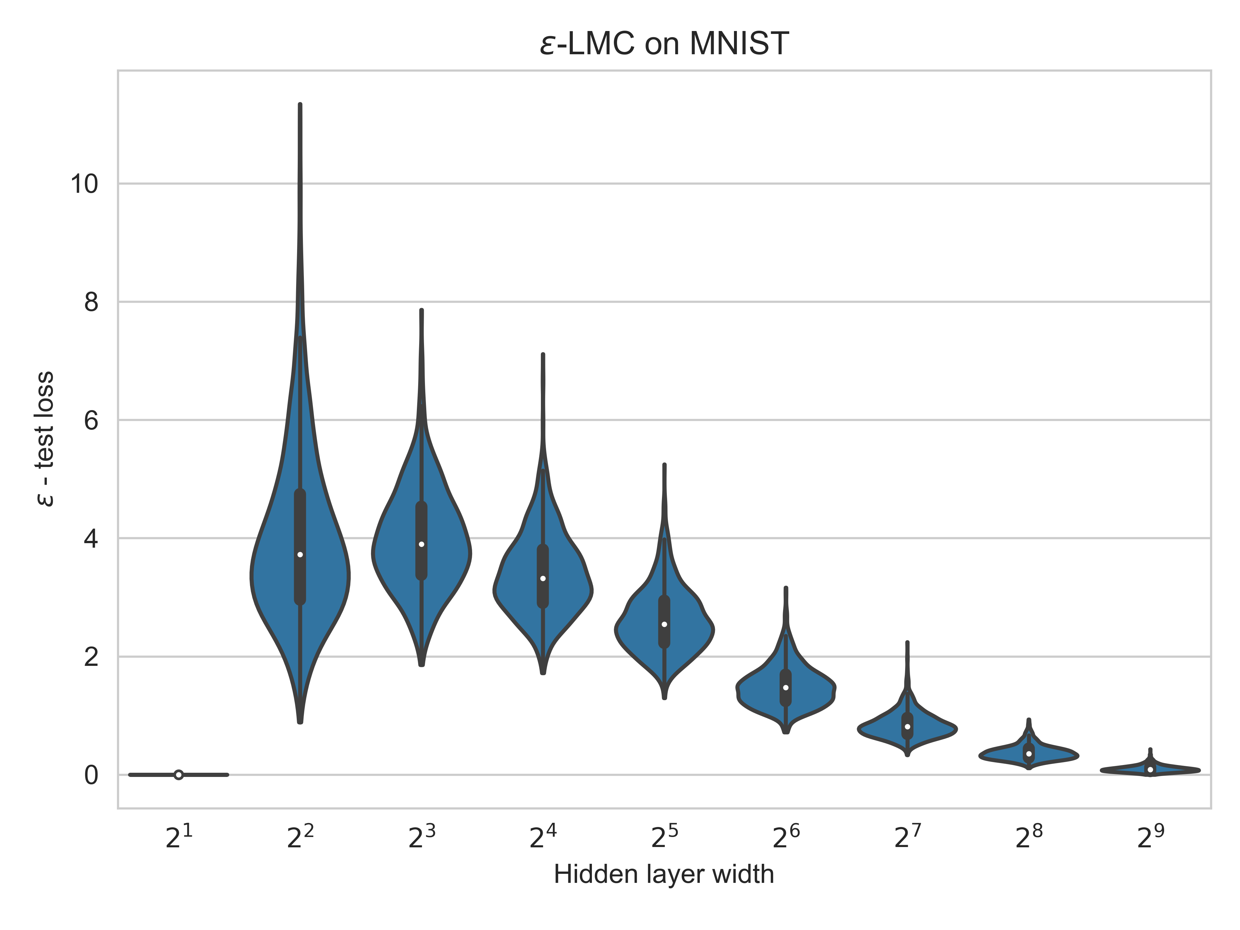
Interpolation: naïve networks
Networks are more linearly mode connected with increasing hidden layer width even without reparameterization

Slide 16
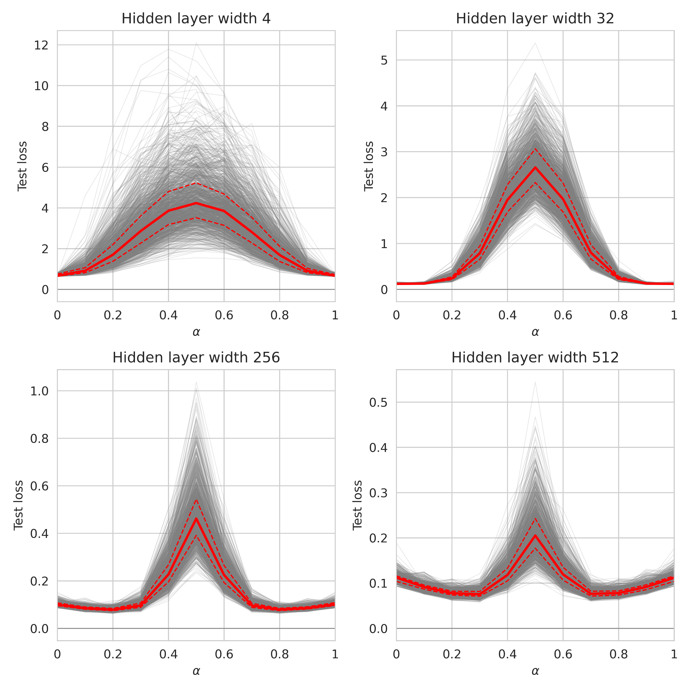
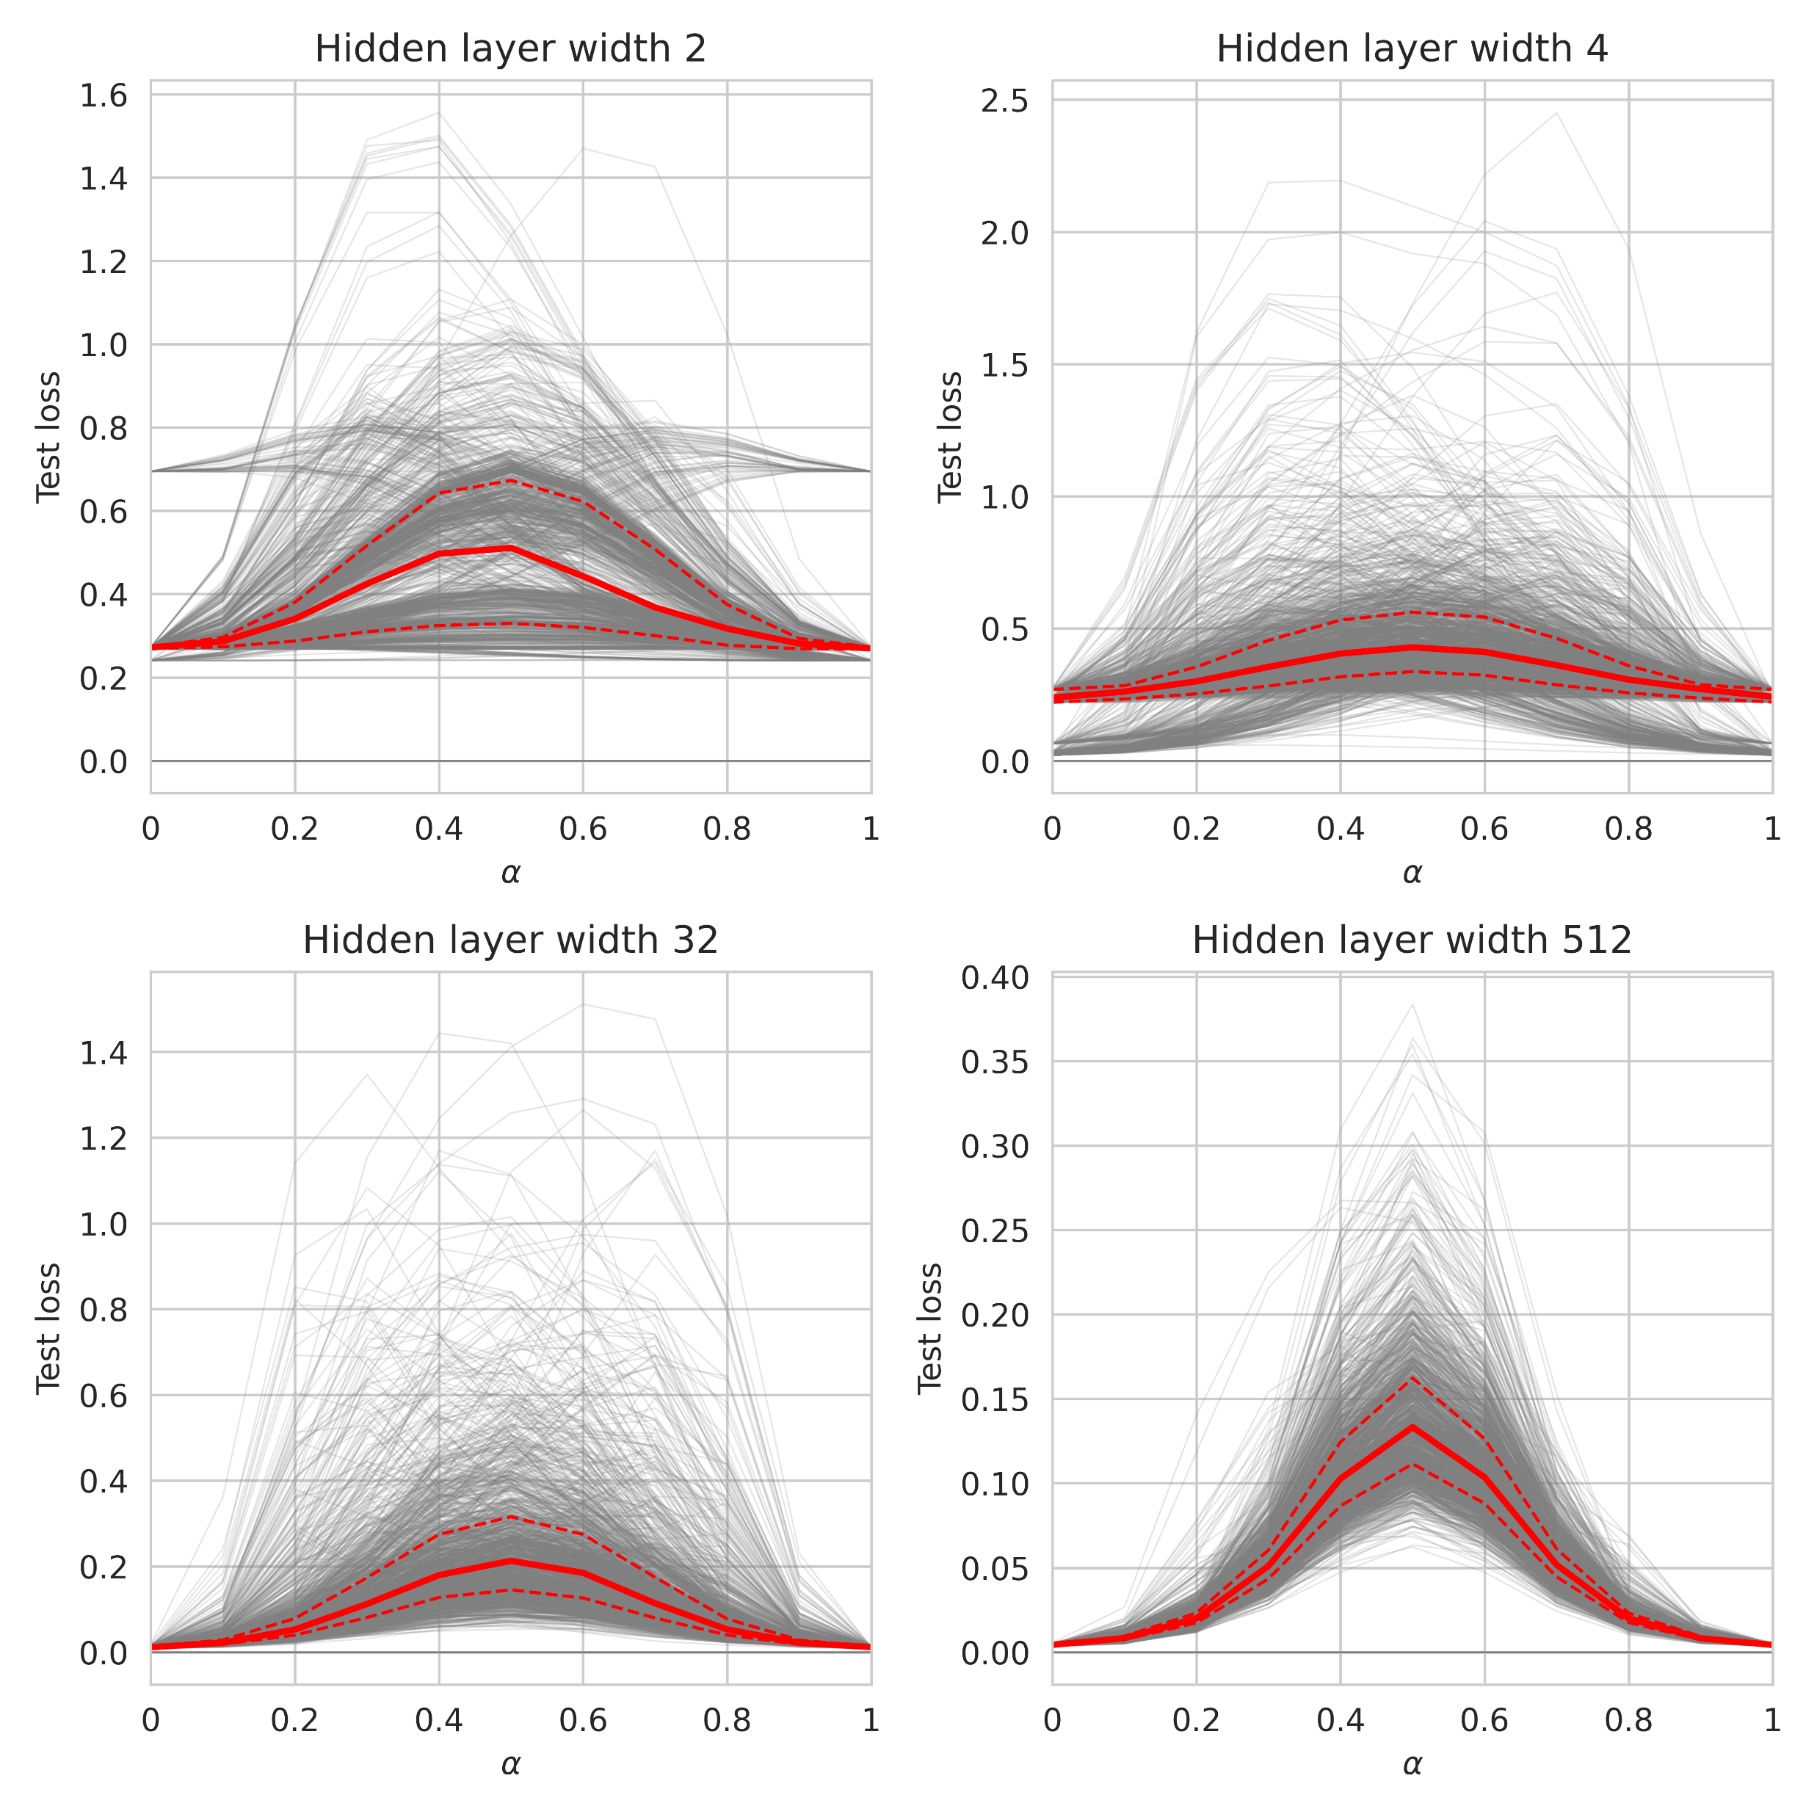
Naïve interpolation: a closer look
Moons
MNIST
Average of two trained networks is worse, but not by much

Slide 17
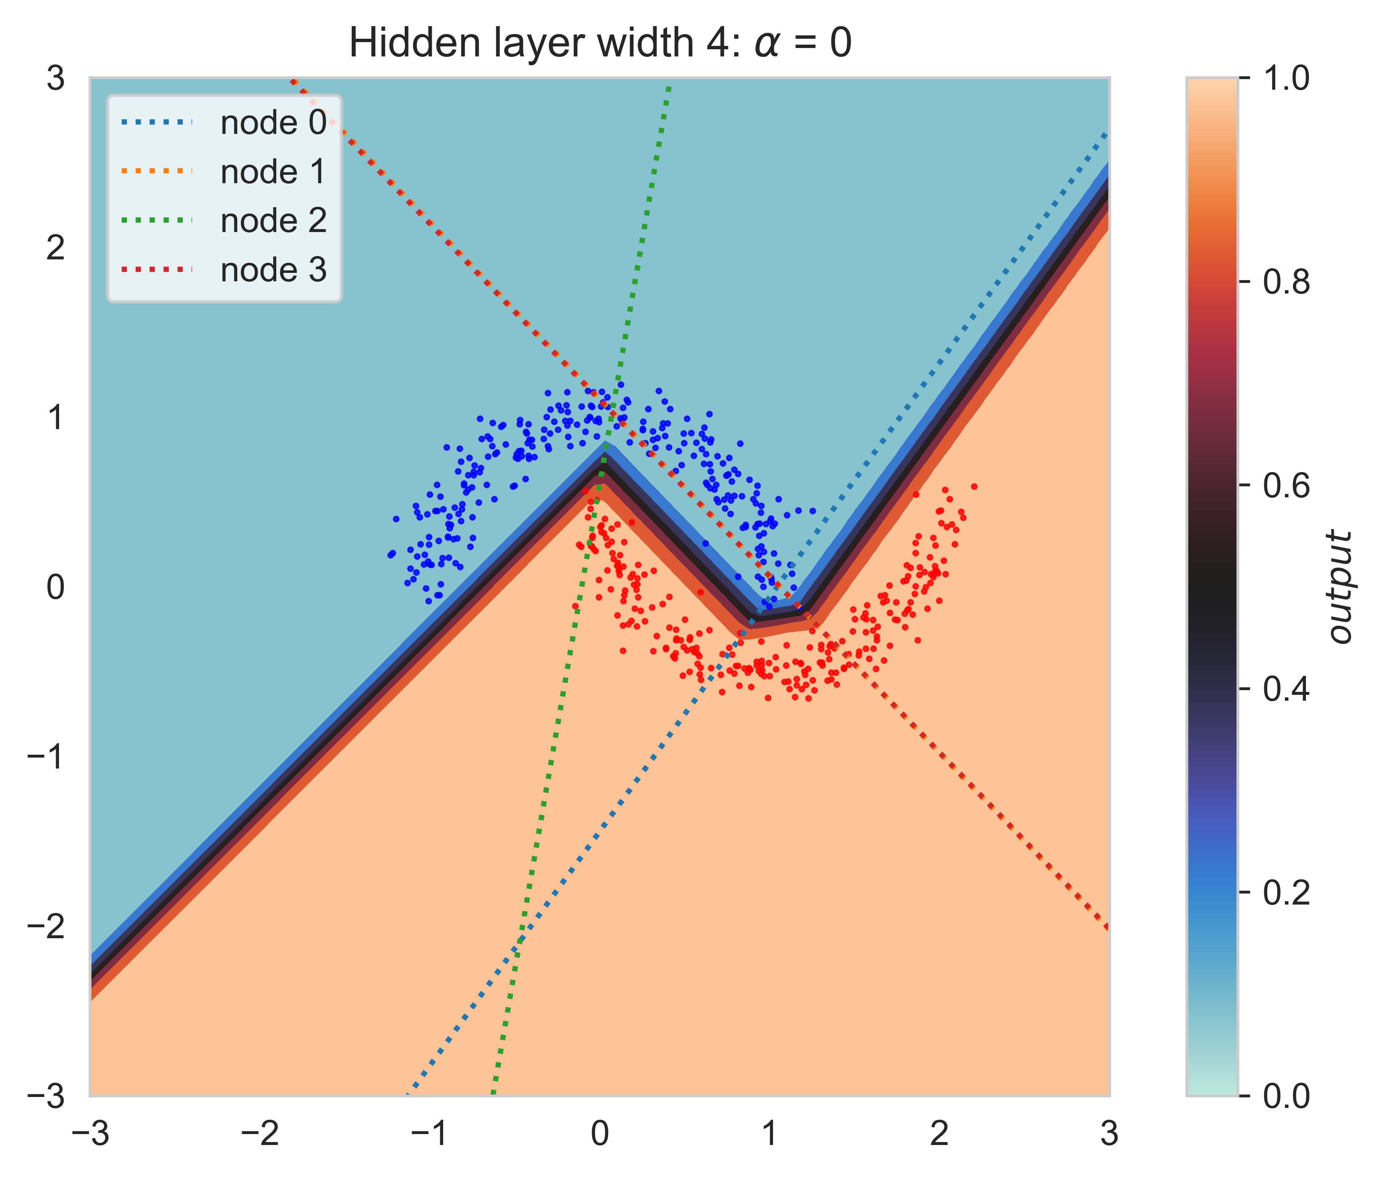
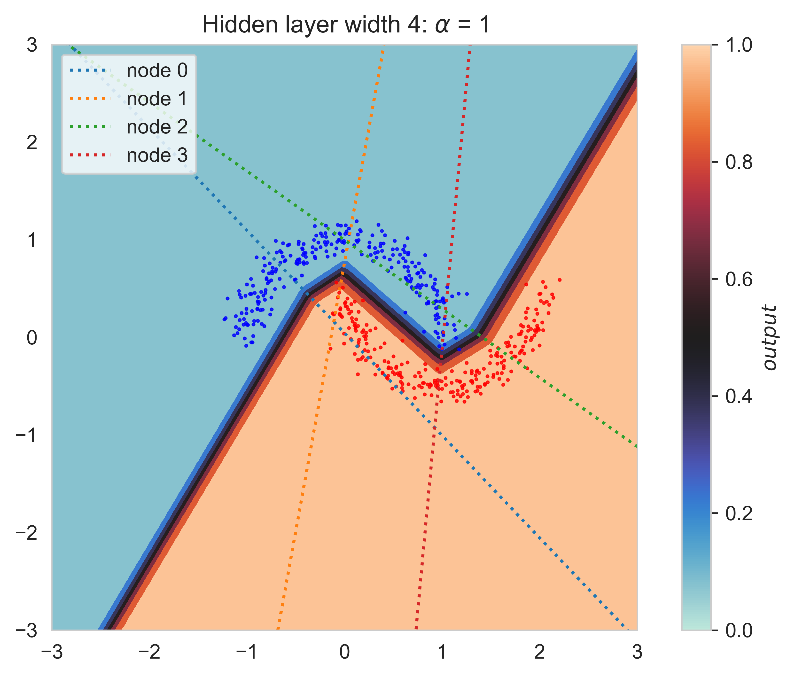
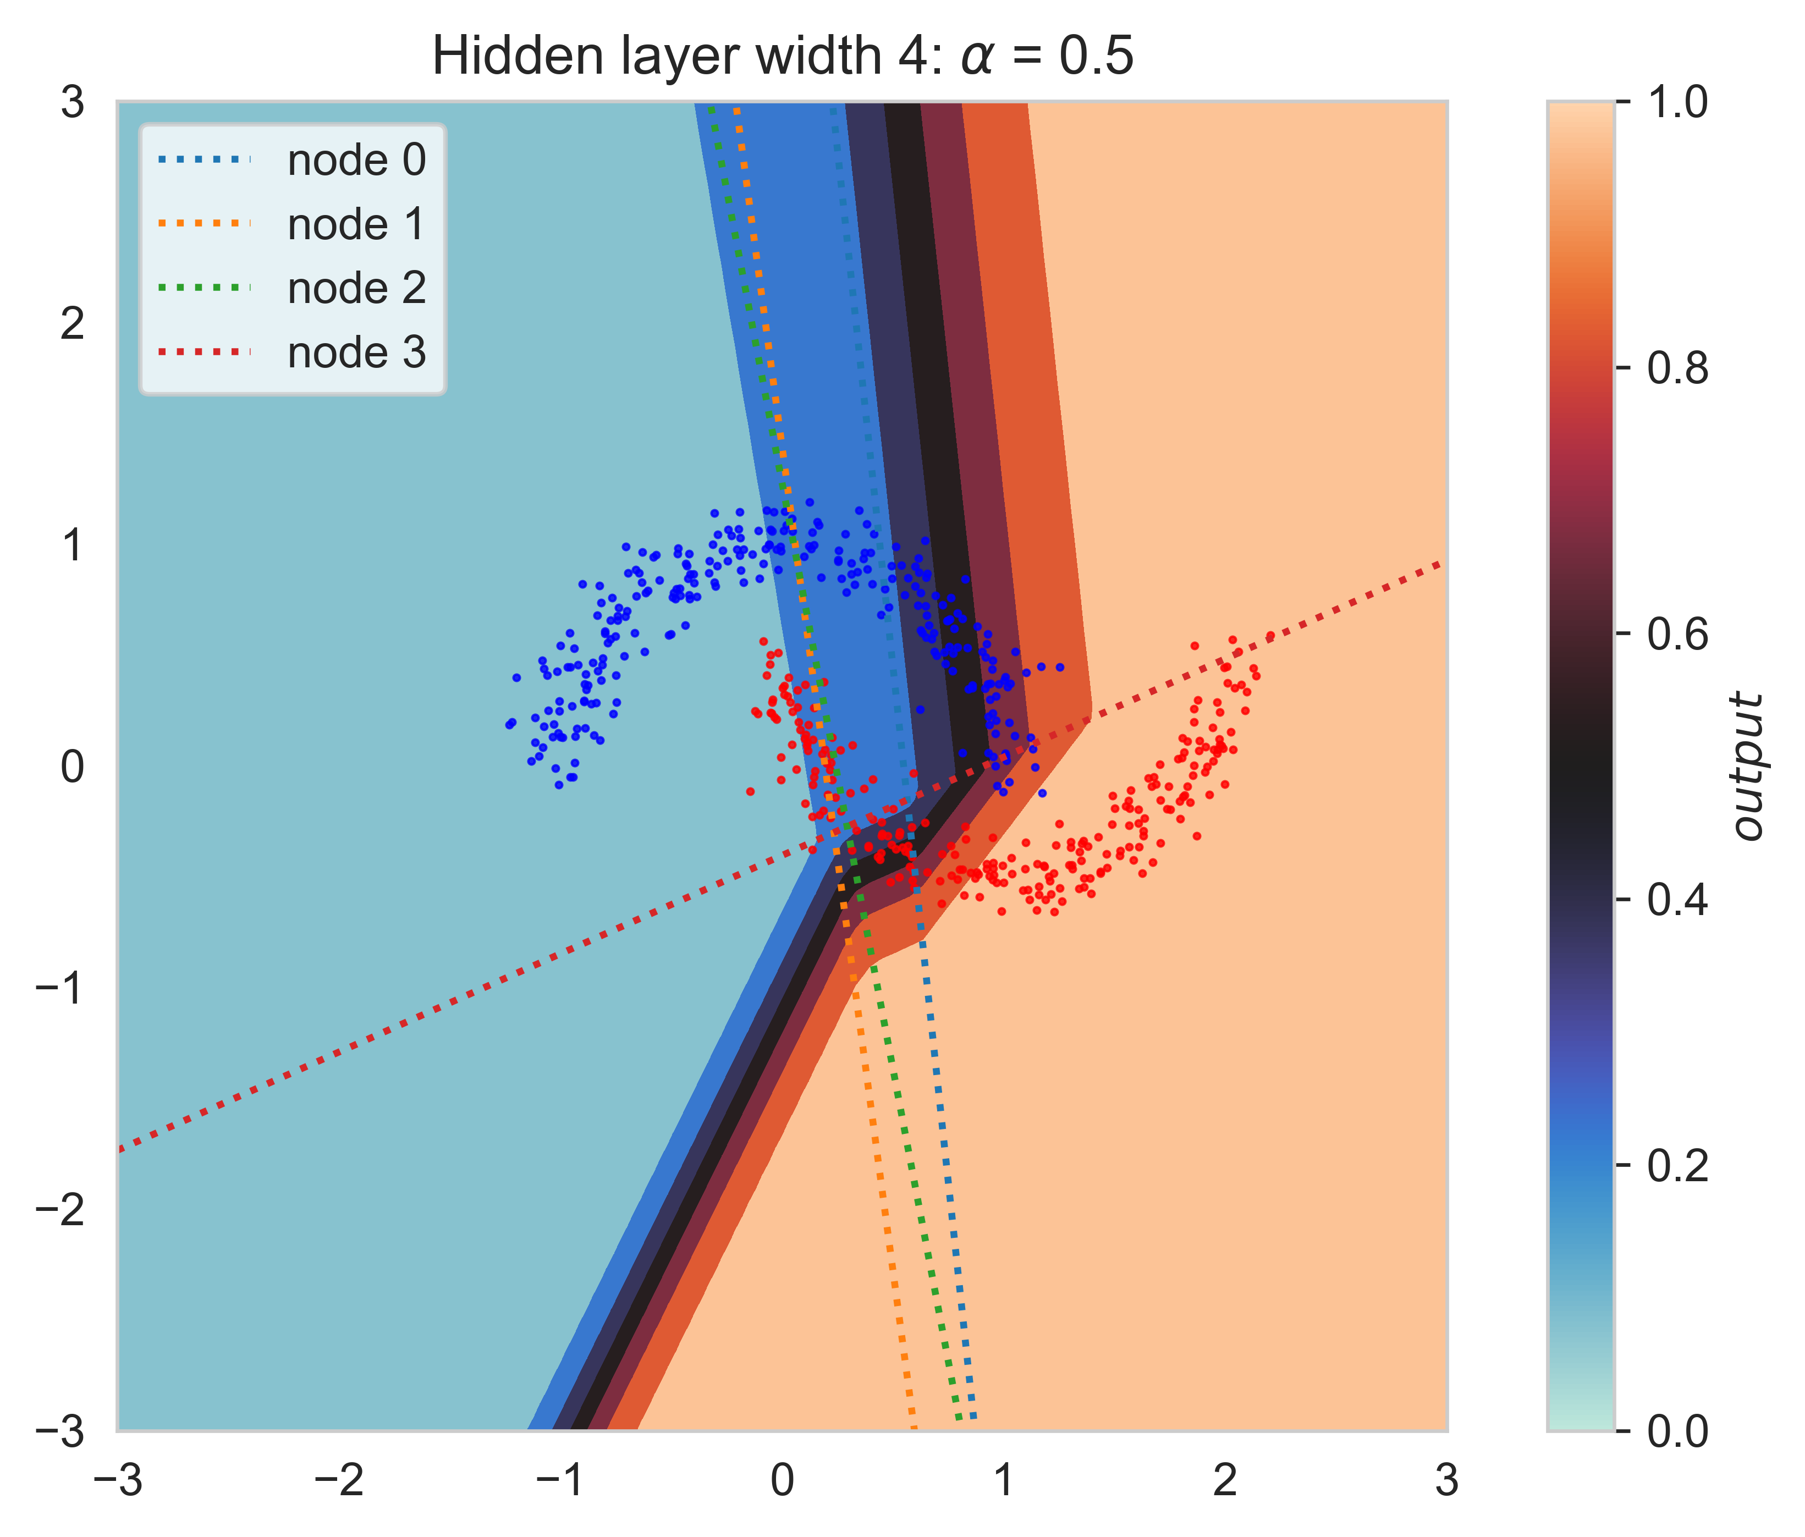
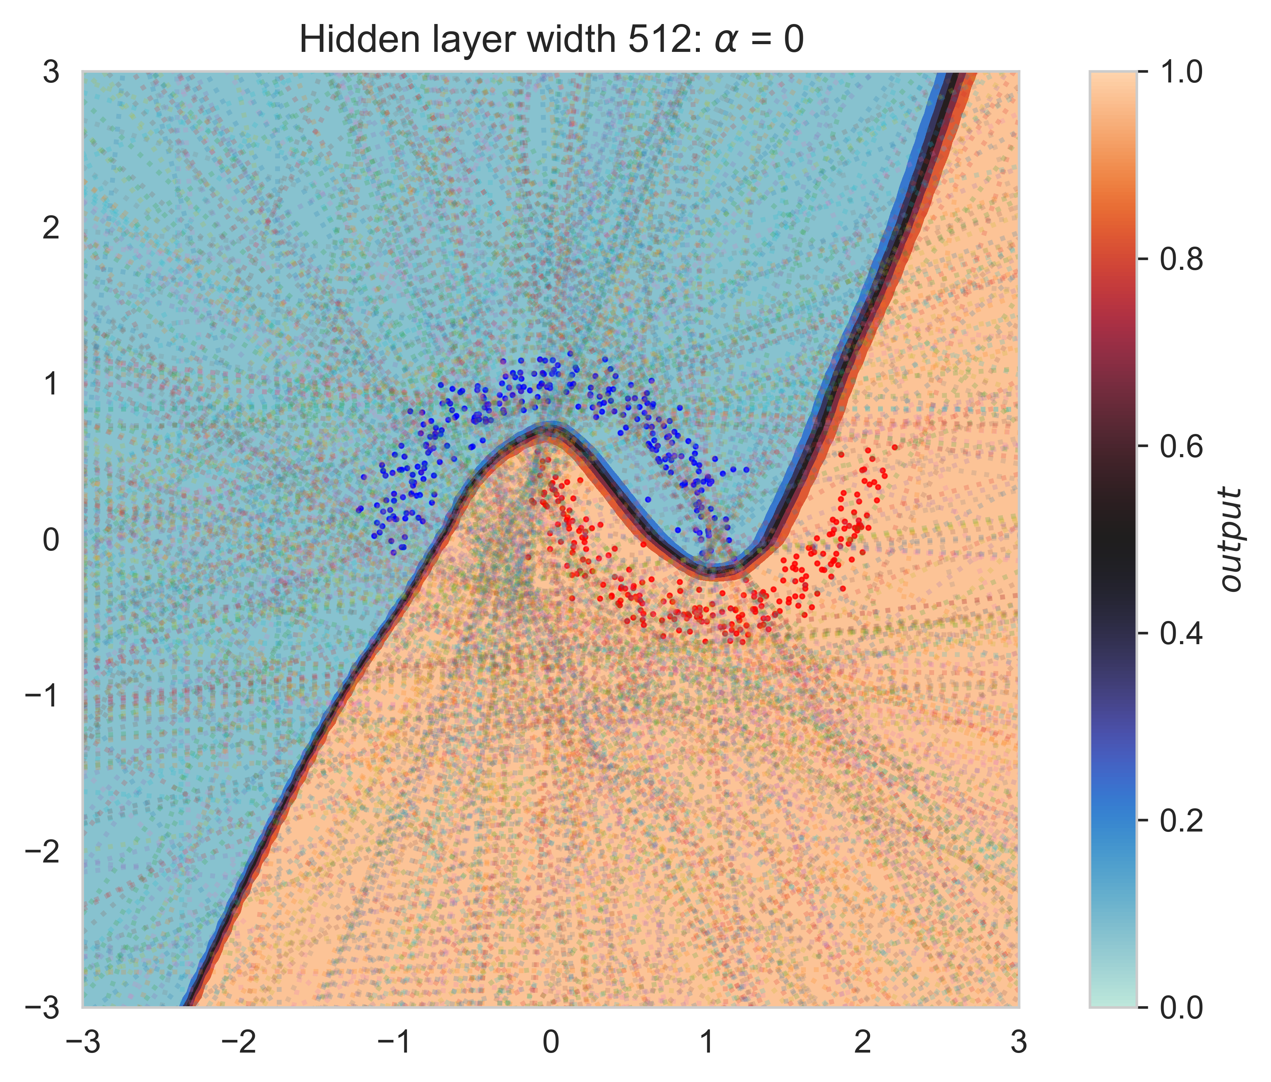
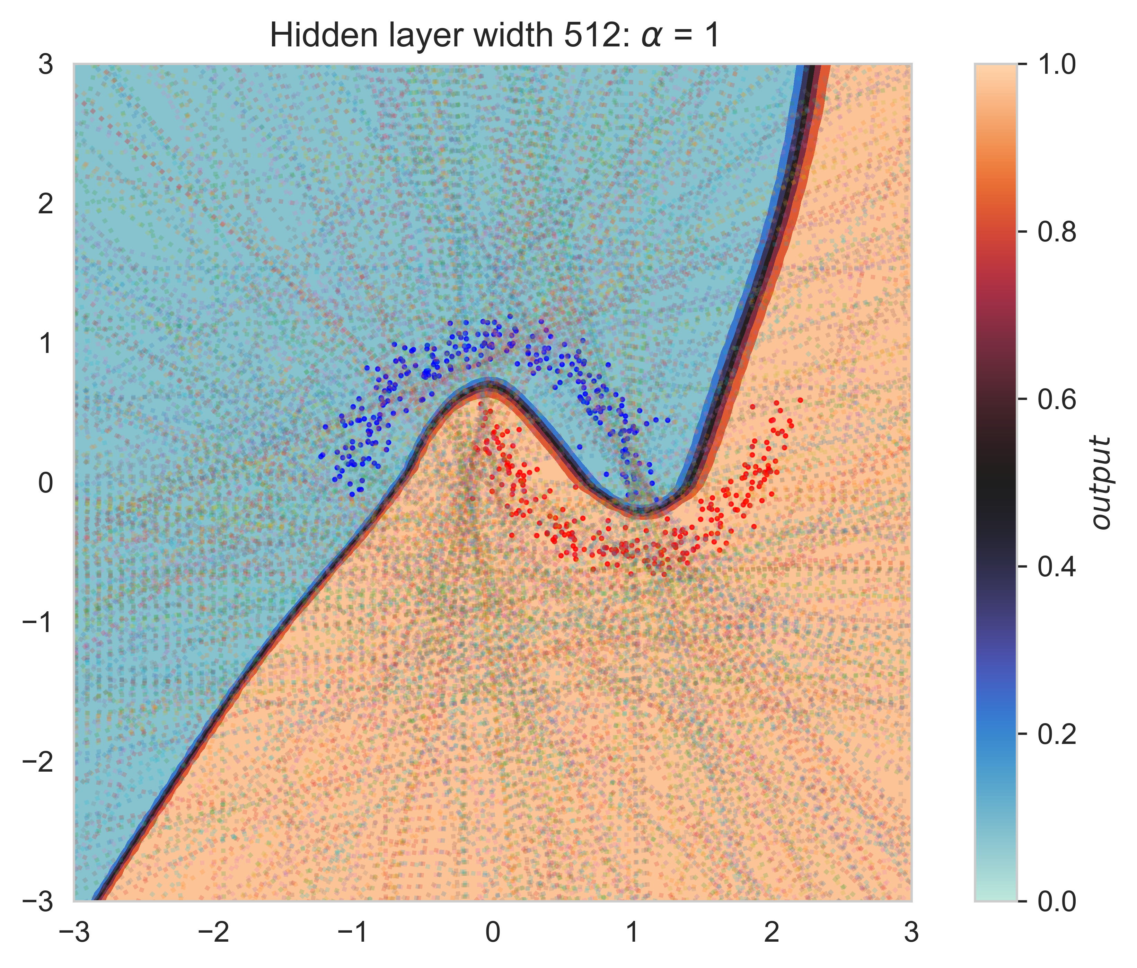
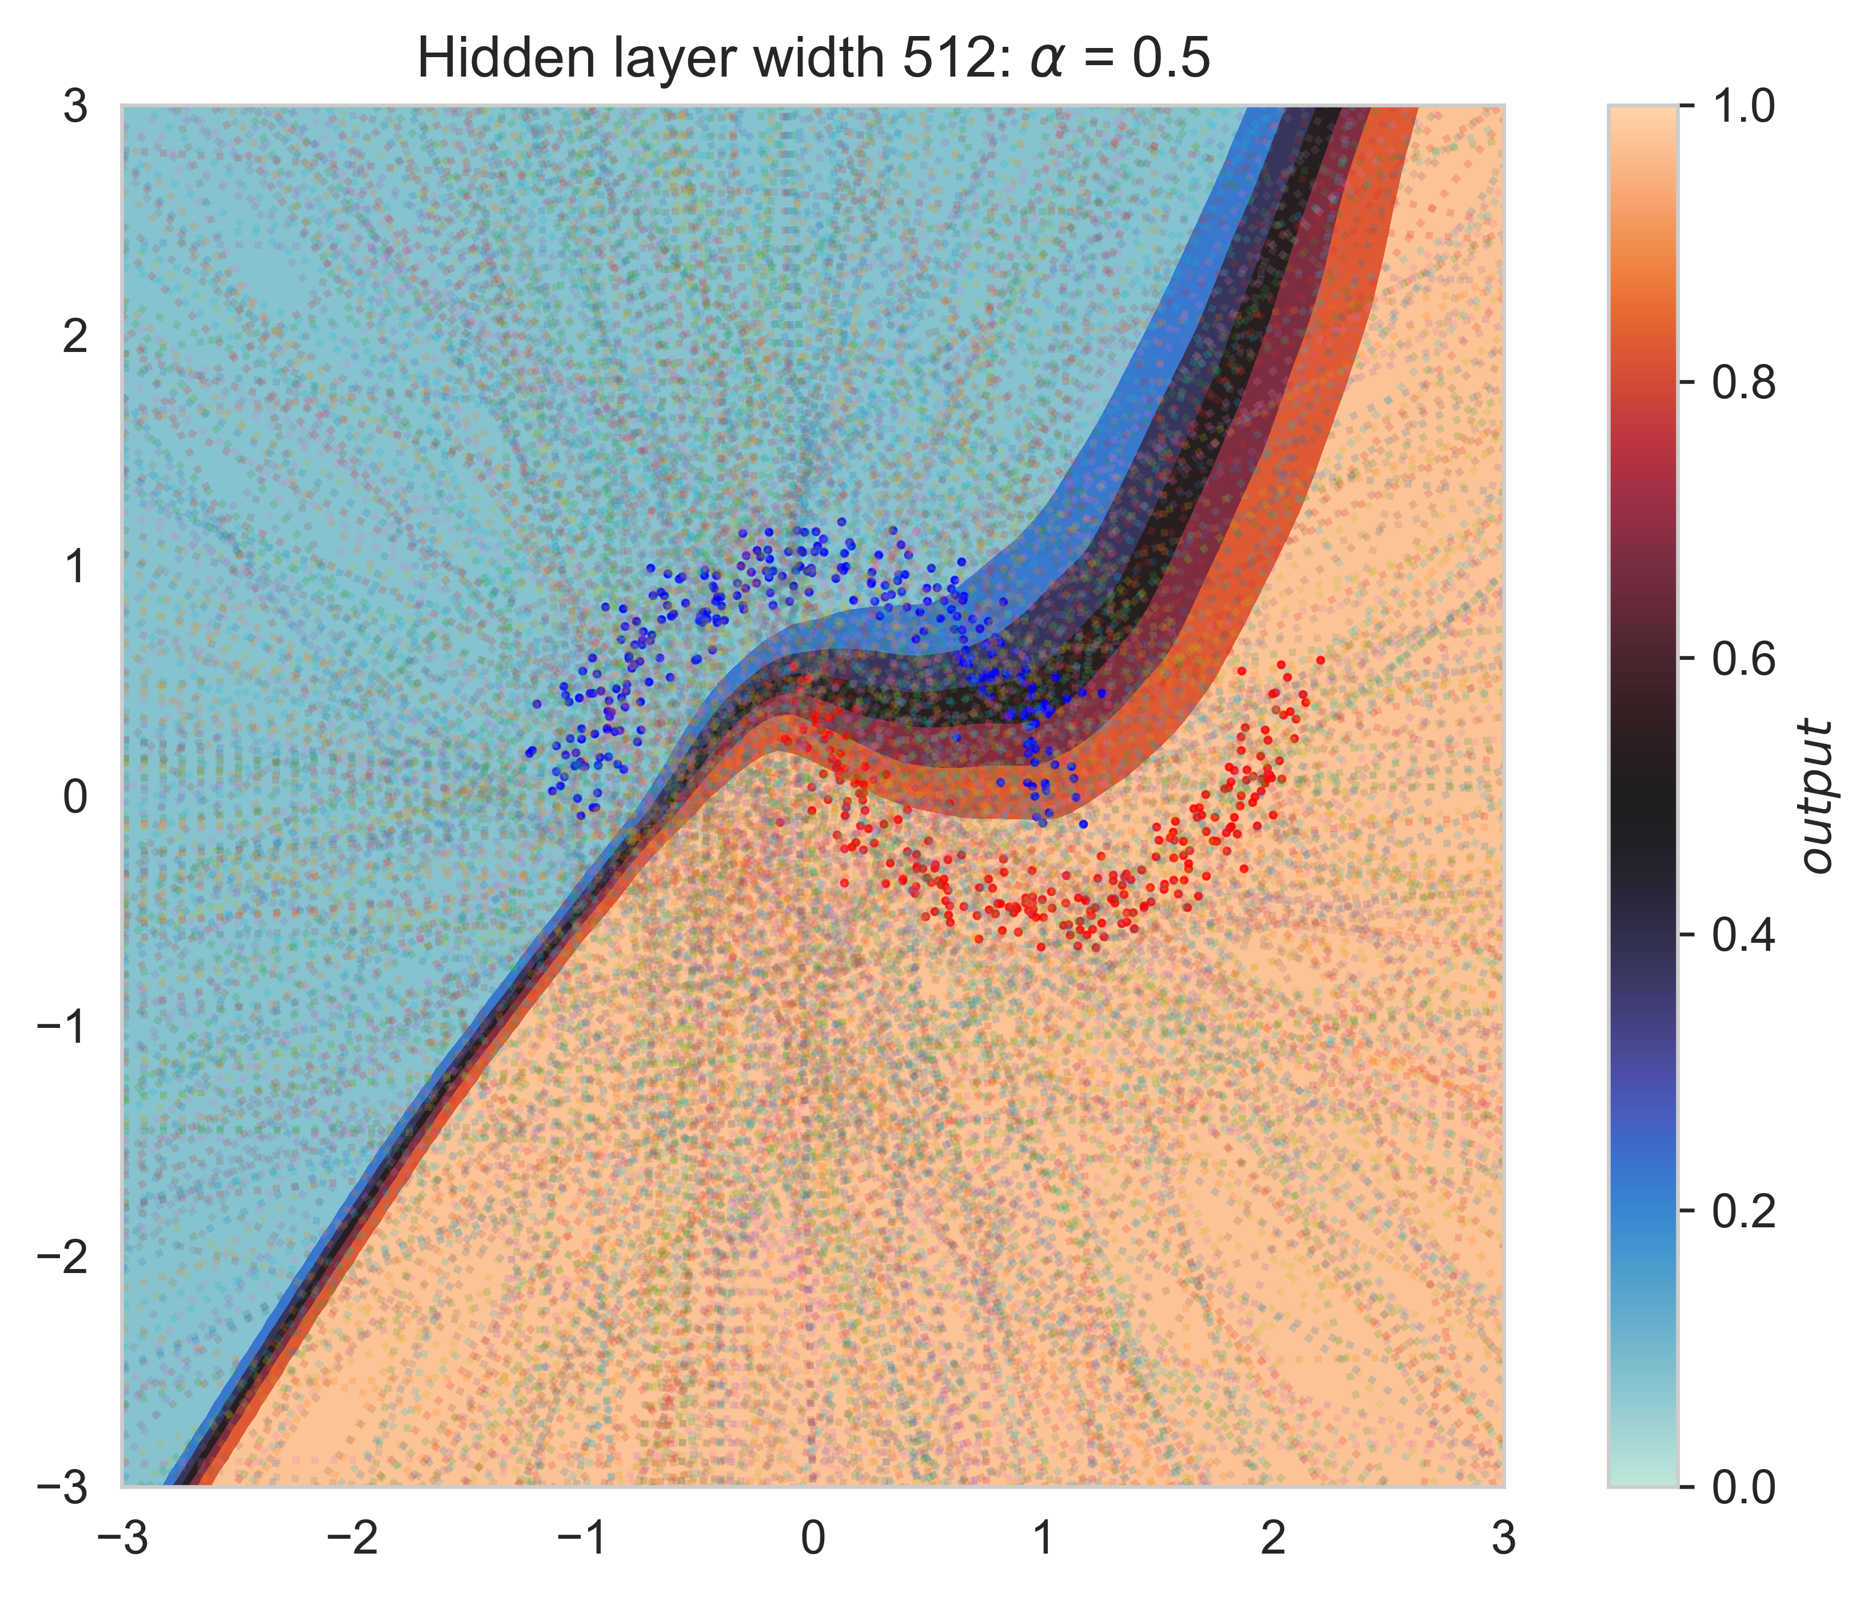
Linear regions and decision boundaries
In wide networks, multiple hidden units compute the same features

Slide 18
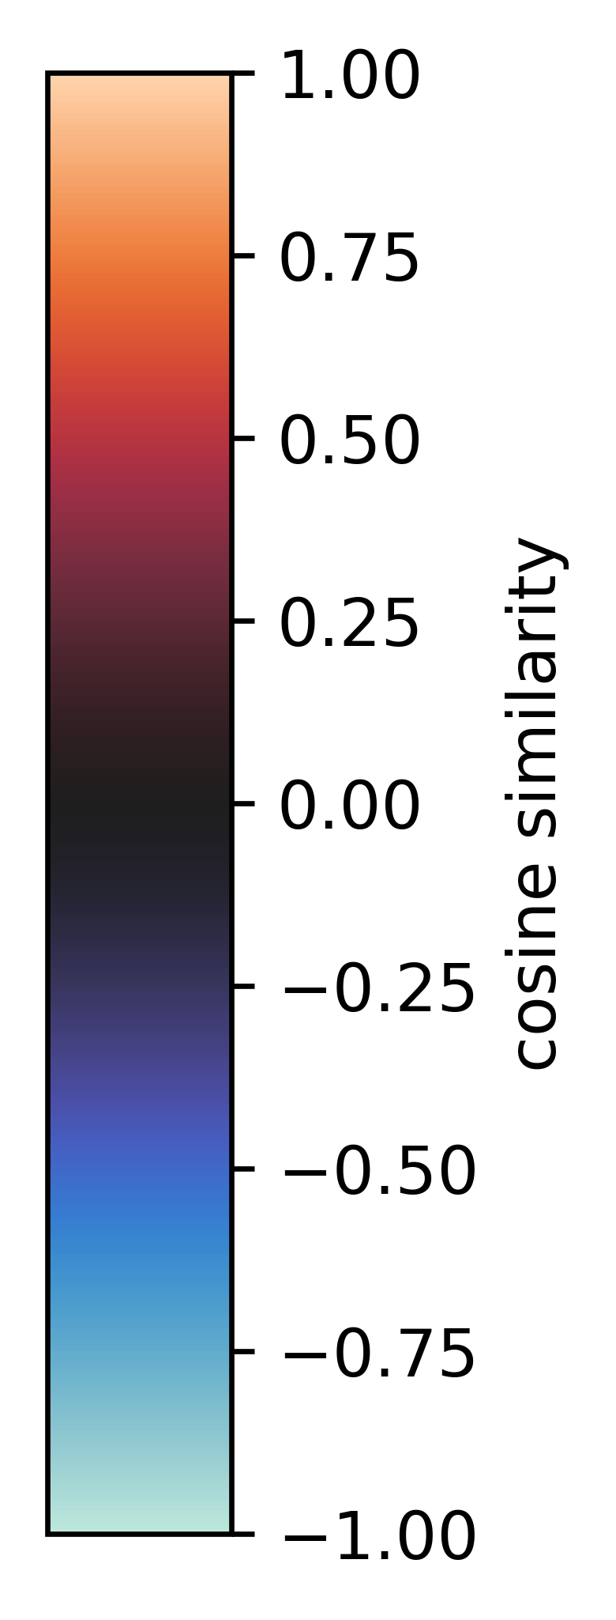
Feature similarity
Redundancies in features lead to lowering loss barrier in wide networks, as hidden units are more likely to be aligned

Slide 19
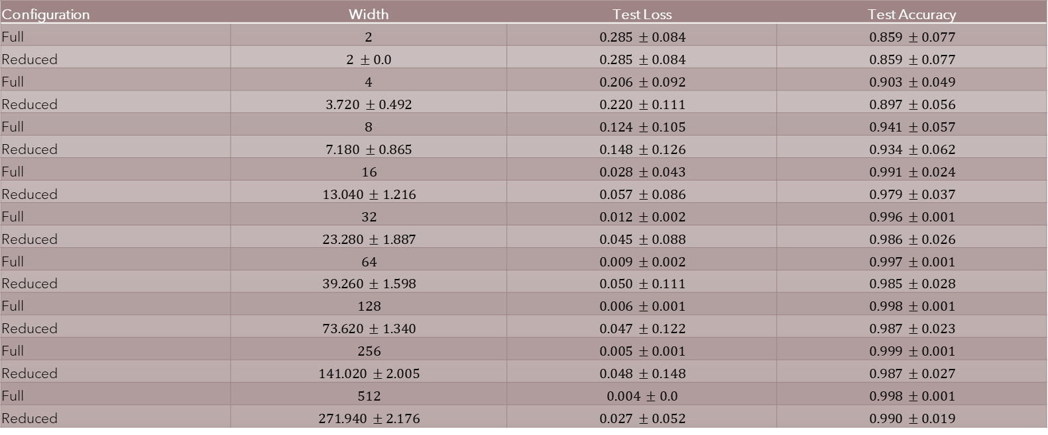
So, what if we prune the networks?
Configuration | Width | Test Loss | Test Accuracy
Full | $$2$$ | $$0.285 ±0.084$$ | $$0.859 ±0.077$$
Reduced | $$2 ±0.0$$ | $$0.285 ±0.084$$ | $$0.859 ±0.077$$
Full | $$4$$ | $$0.206 ±0.092$$ | $$0.903 ±0.049$$
Reduced | $$3.720 ±0.492$$ | $$0.220 ±0.111$$ | $$0.897 ±0.056$$
Full | $$8$$ | $$0.124 ±0.105$$ | $$0.941 ±0.057$$
Reduced | $$7.180 ±0.865$$ | $$0.148 ±0.126$$ | $$0.934 ±0.062$$
Full | $$16$$ | $$0.028 ±0.043$$ | $$0.991 ±0.024$$
Reduced | $$13.040 ±1.216$$ | $$0.057 ±0.086$$ | $$0.979 ±0.037$$
Full | $$32$$ | $$0.012 ±0.002$$ | $$0.996 ±0.001$$
Reduced | $$23.280 ±1.887$$ | $$0.045 ±0.088$$ | $$0.986 ±0.026$$
Full | $$64$$ | $$0.009 ±0.002$$ | $$0.997 ±0.001$$
Reduced | $$39.260 ±1.598$$ | $$0.050 ±0.111$$ | $$0.985 ±0.028$$
Full | $$128$$ | $$0.006 ±0.001$$ | $$0.998 ±0.001$$
Reduced | $$73.620 ±1.340$$ | $$0.047 ±0.122$$ | $$0.987 ±0.023$$
Full | $$256$$ | $$0.005 ±0.001$$ | $$0.999 ±0.001$$
Reduced | $$141.020 ±2.005$$ | $$0.048 ±0.148$$ | $$0.987 ±0.027$$
Full | $$512$$ | $$0.004 ±0.0$$ | $$0.998 ±0.001$$
Reduced | $$271.940 ±2.176$$ | $$0.027 ±0.052$$ | $$0.990 ±0.019$$

Slide 20
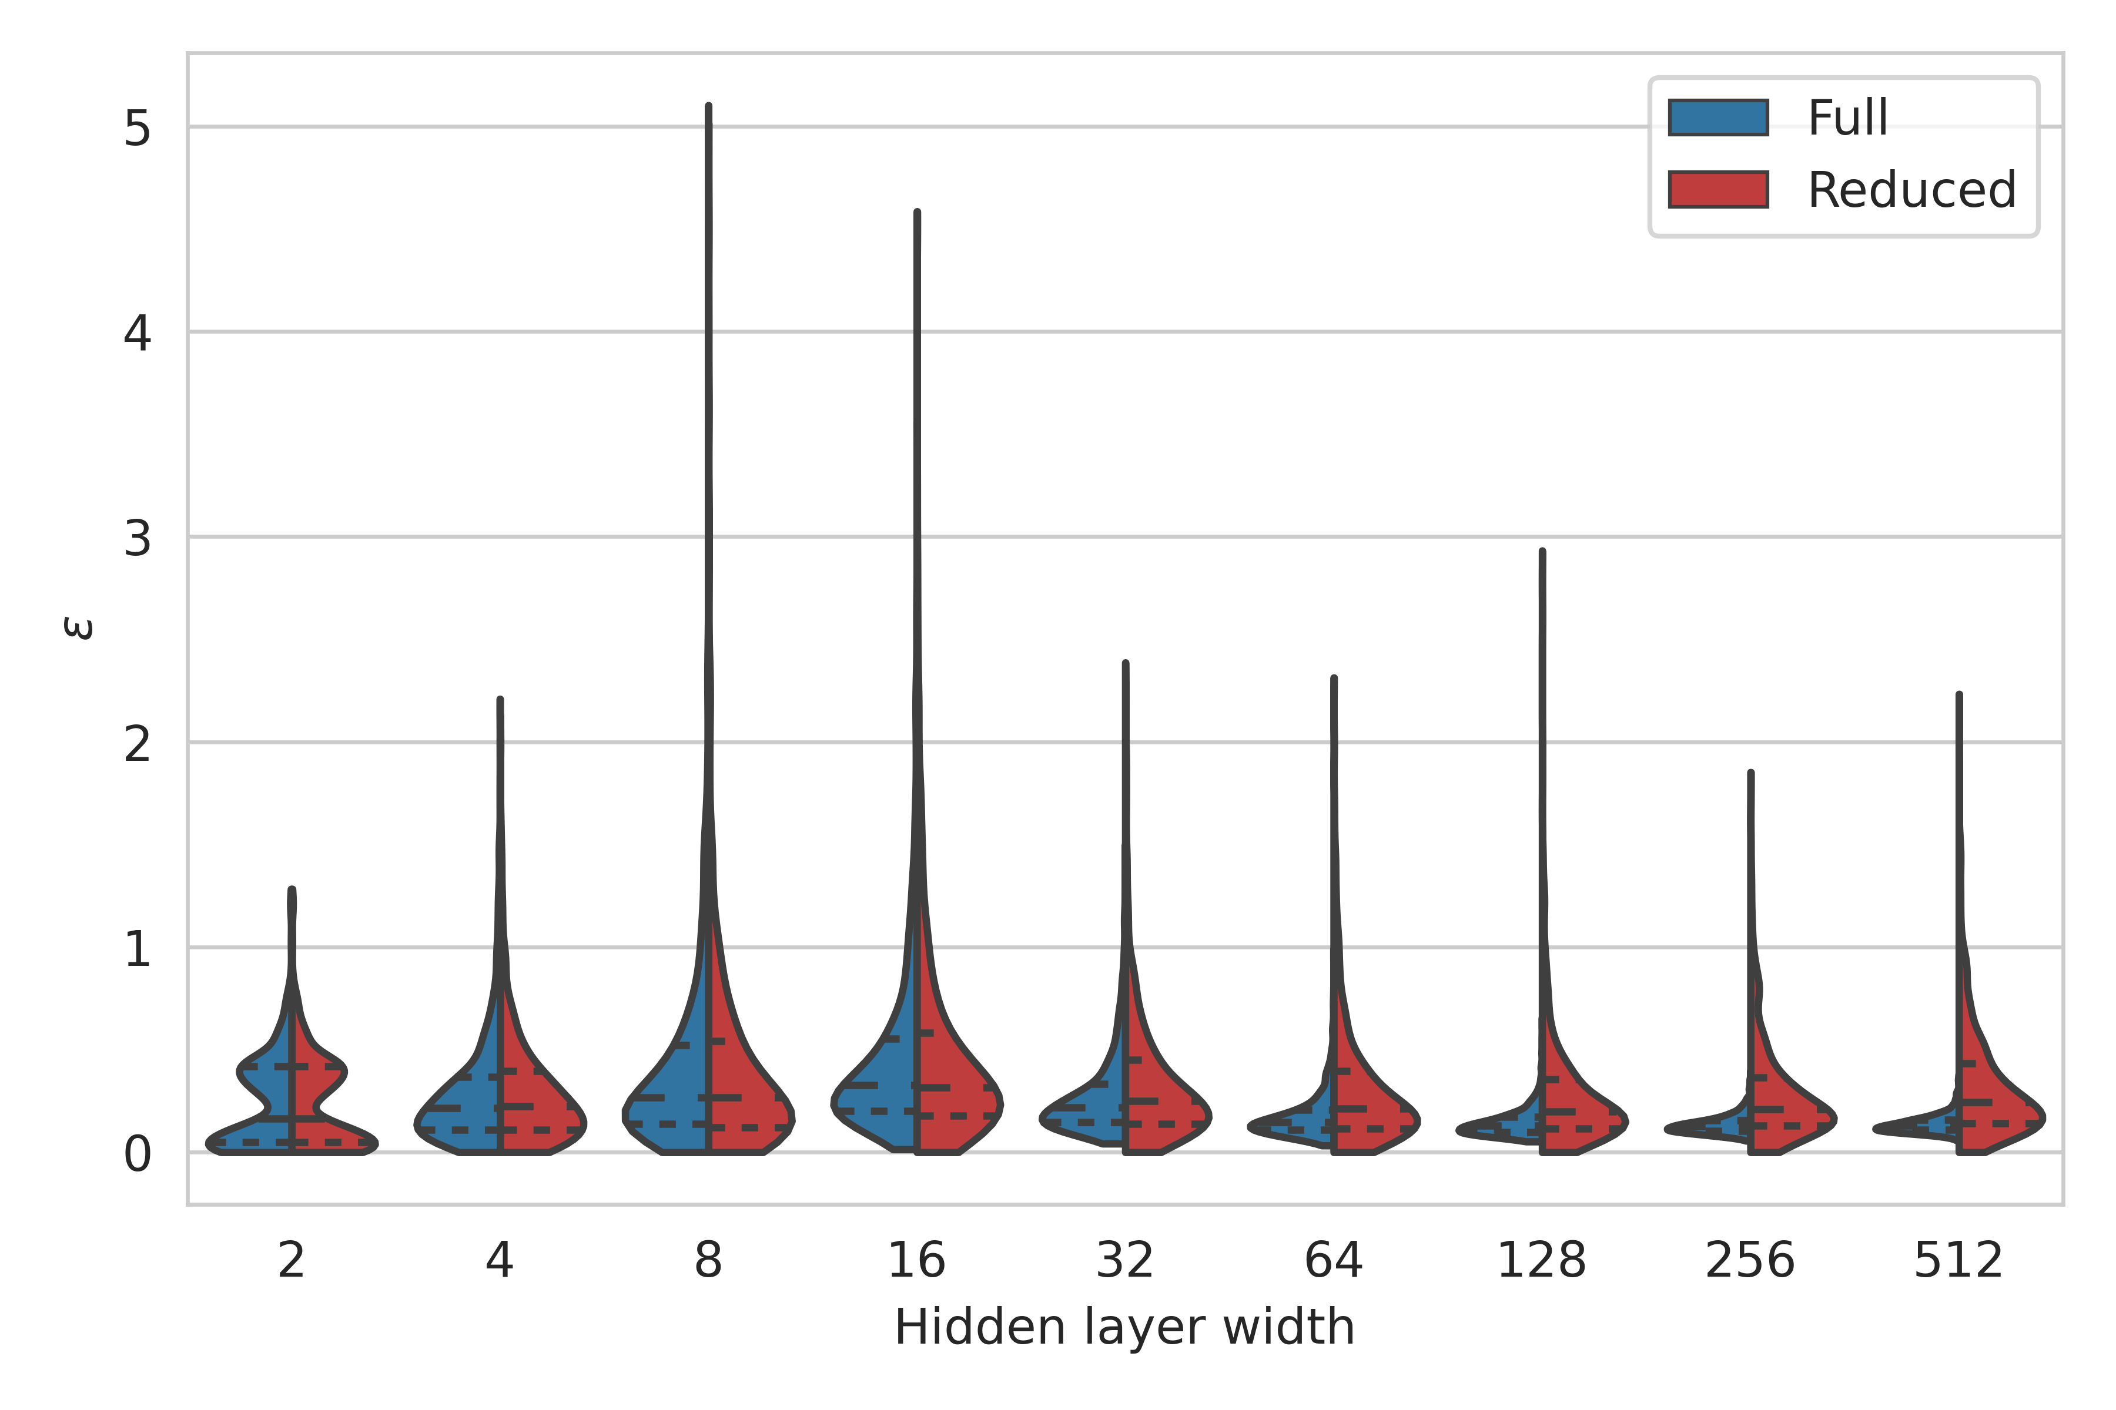
Removing feature redundancies removes LMC upon naïve interpolation

Slide 21
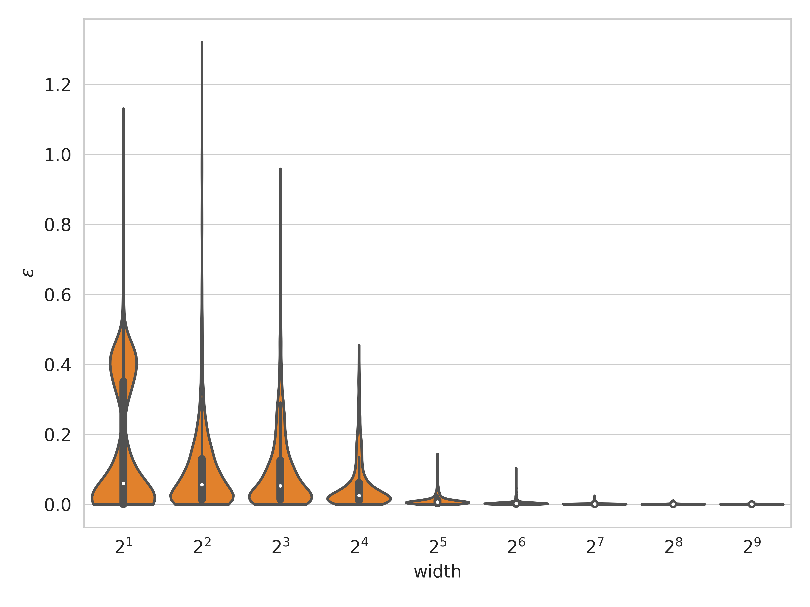
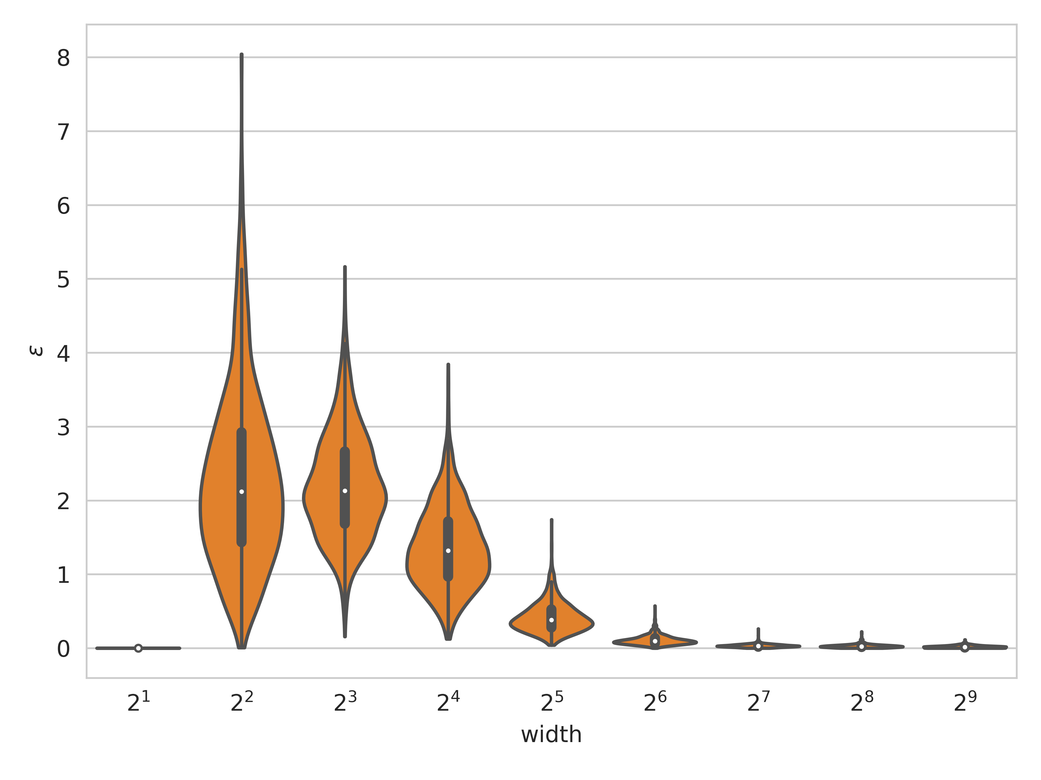
Interpolation: reparameterized networks
Moons
MNIST
Networks are lot more linearly mode connected upon reparameterization

Slide 22
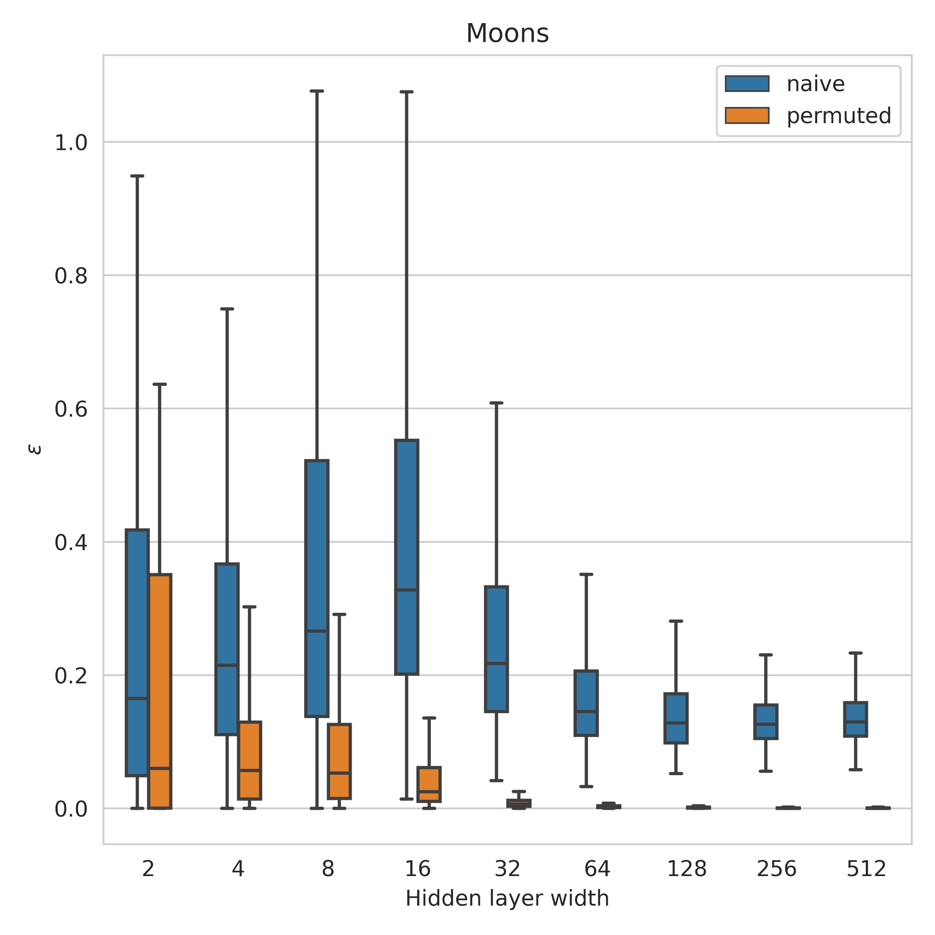
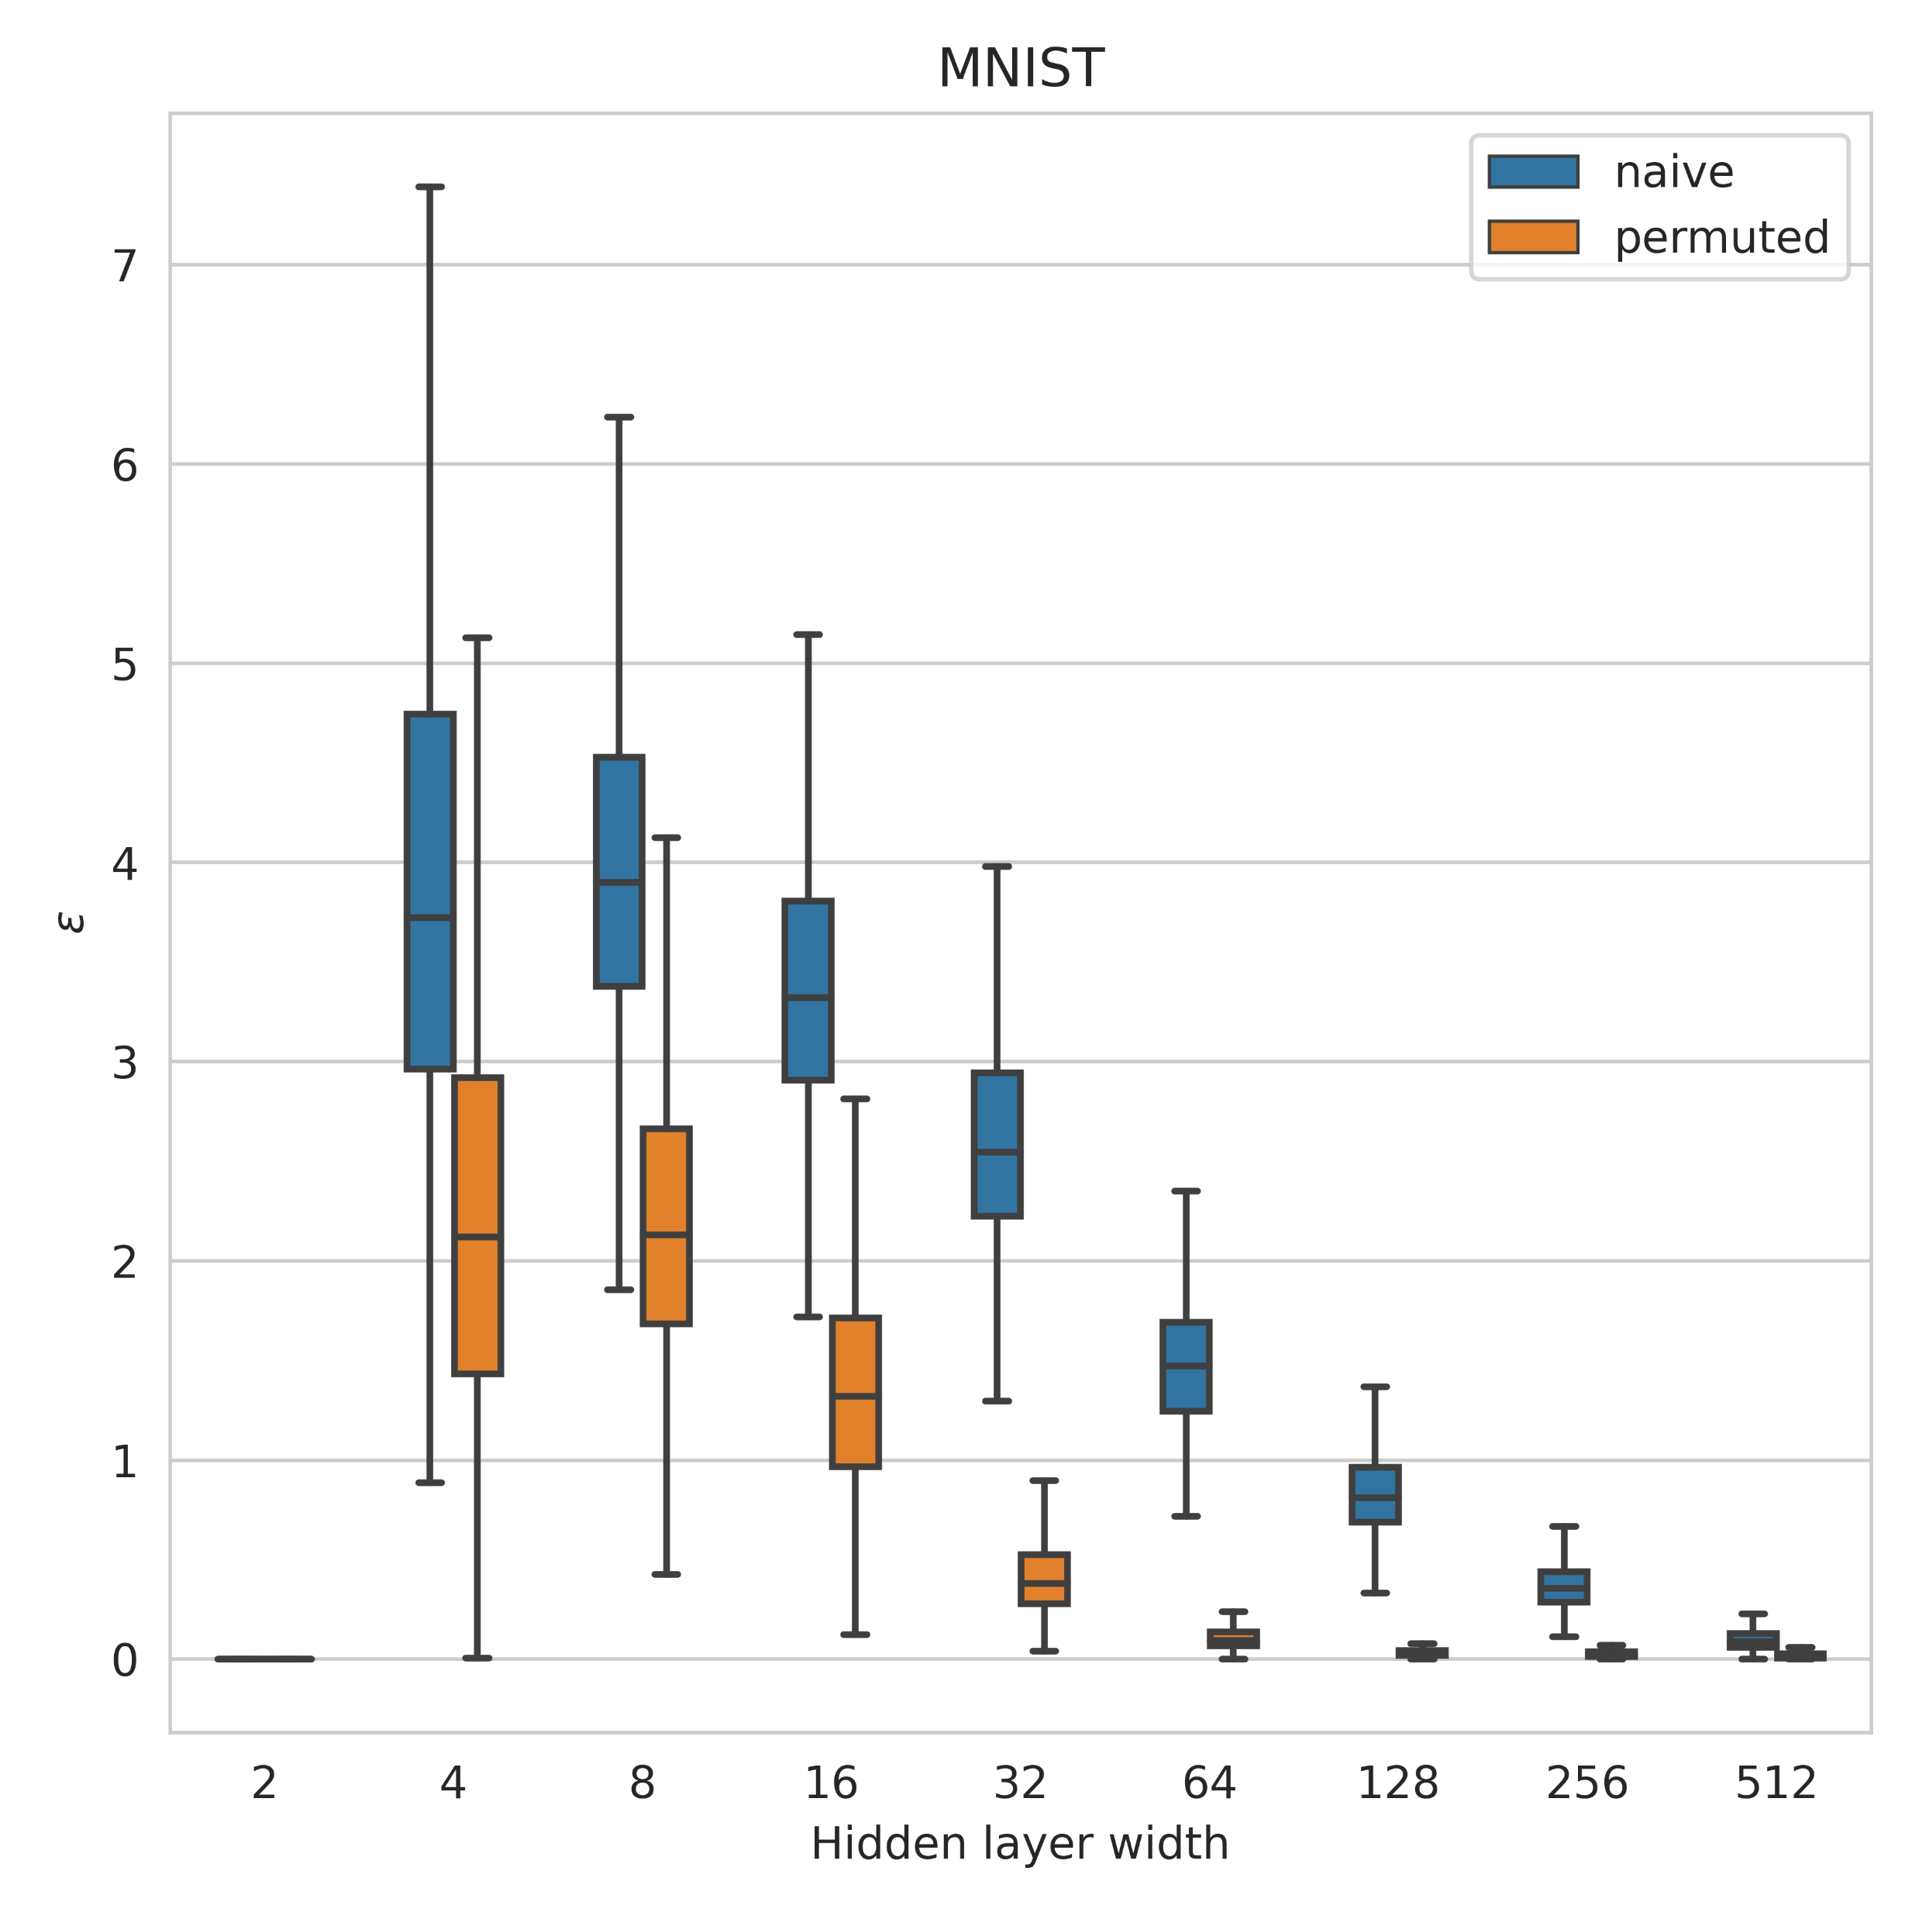
Comparison between naïve and reparameterized interpolations
Outliers are omitted from the plots

Slide 23
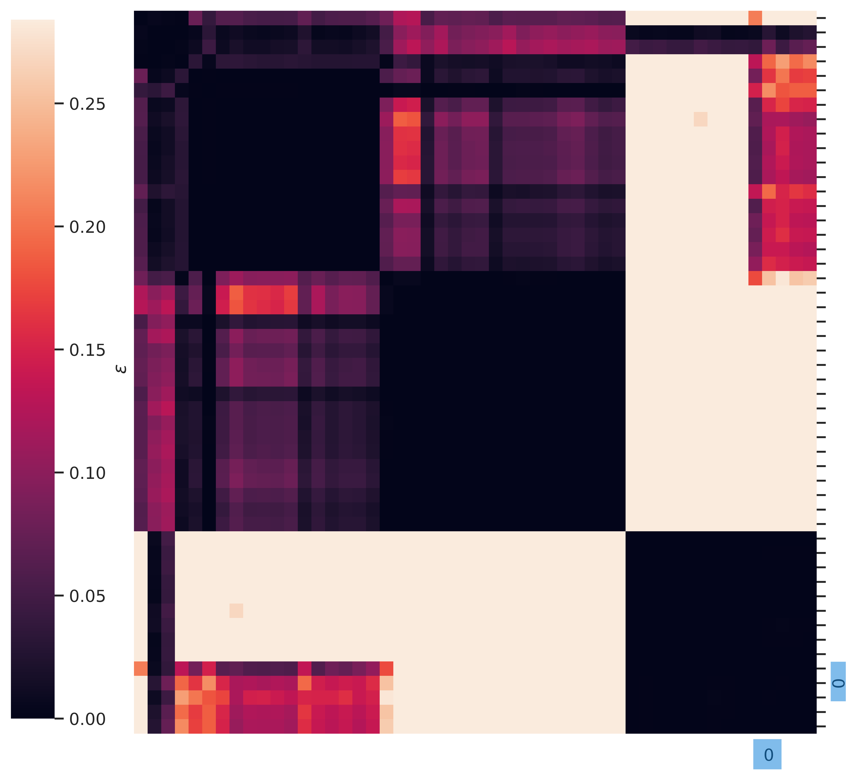
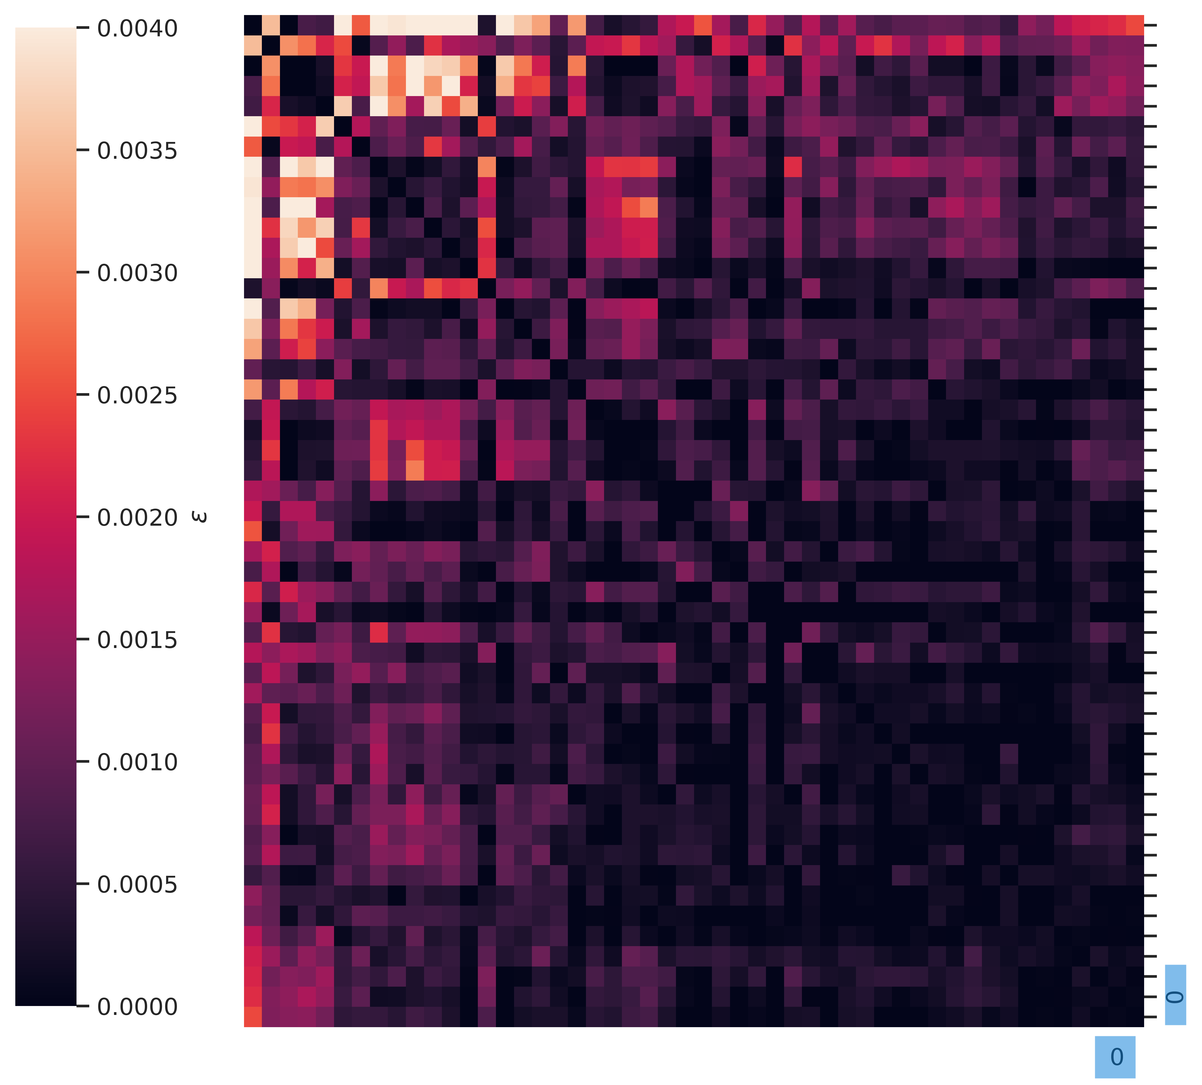
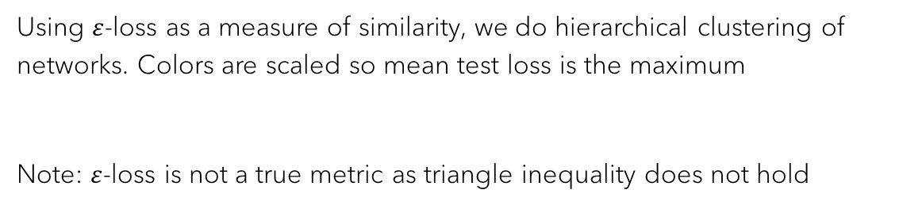
Are there clusters of Moons networks that are LMC with each other and not others?
Width: 2
Width: 8
Width: 512
Using $ε$-loss as a measure of similarity, we do hierarchical clustering of networks. Colors are scaled so mean test loss is the maximum
Note: $ε$-loss is not a true metric as triangle inequality does not hold

Slide 24
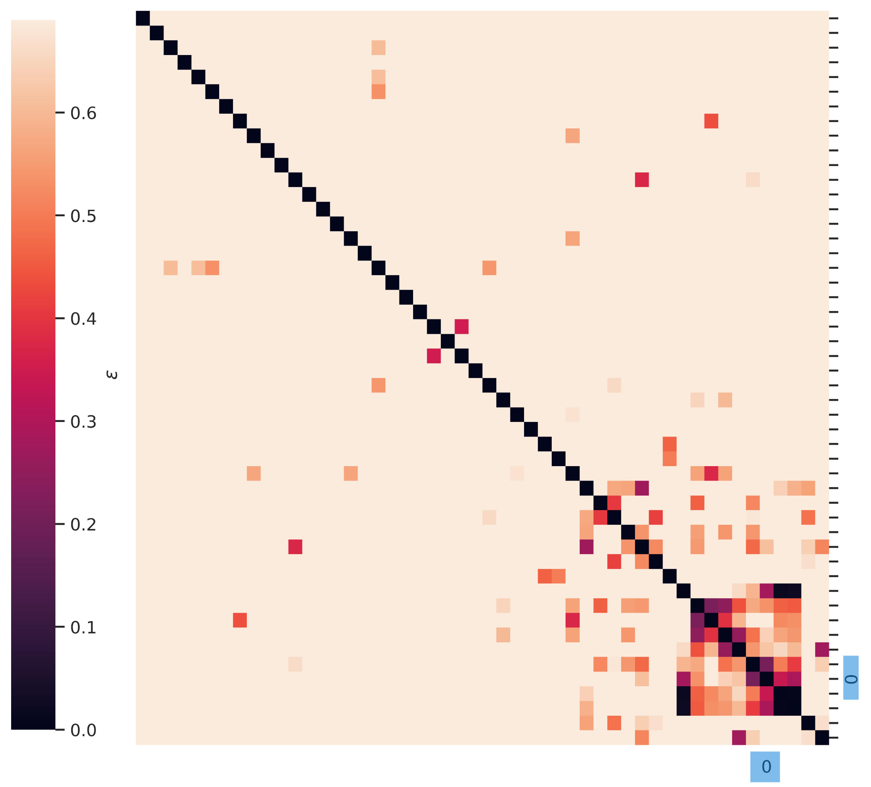
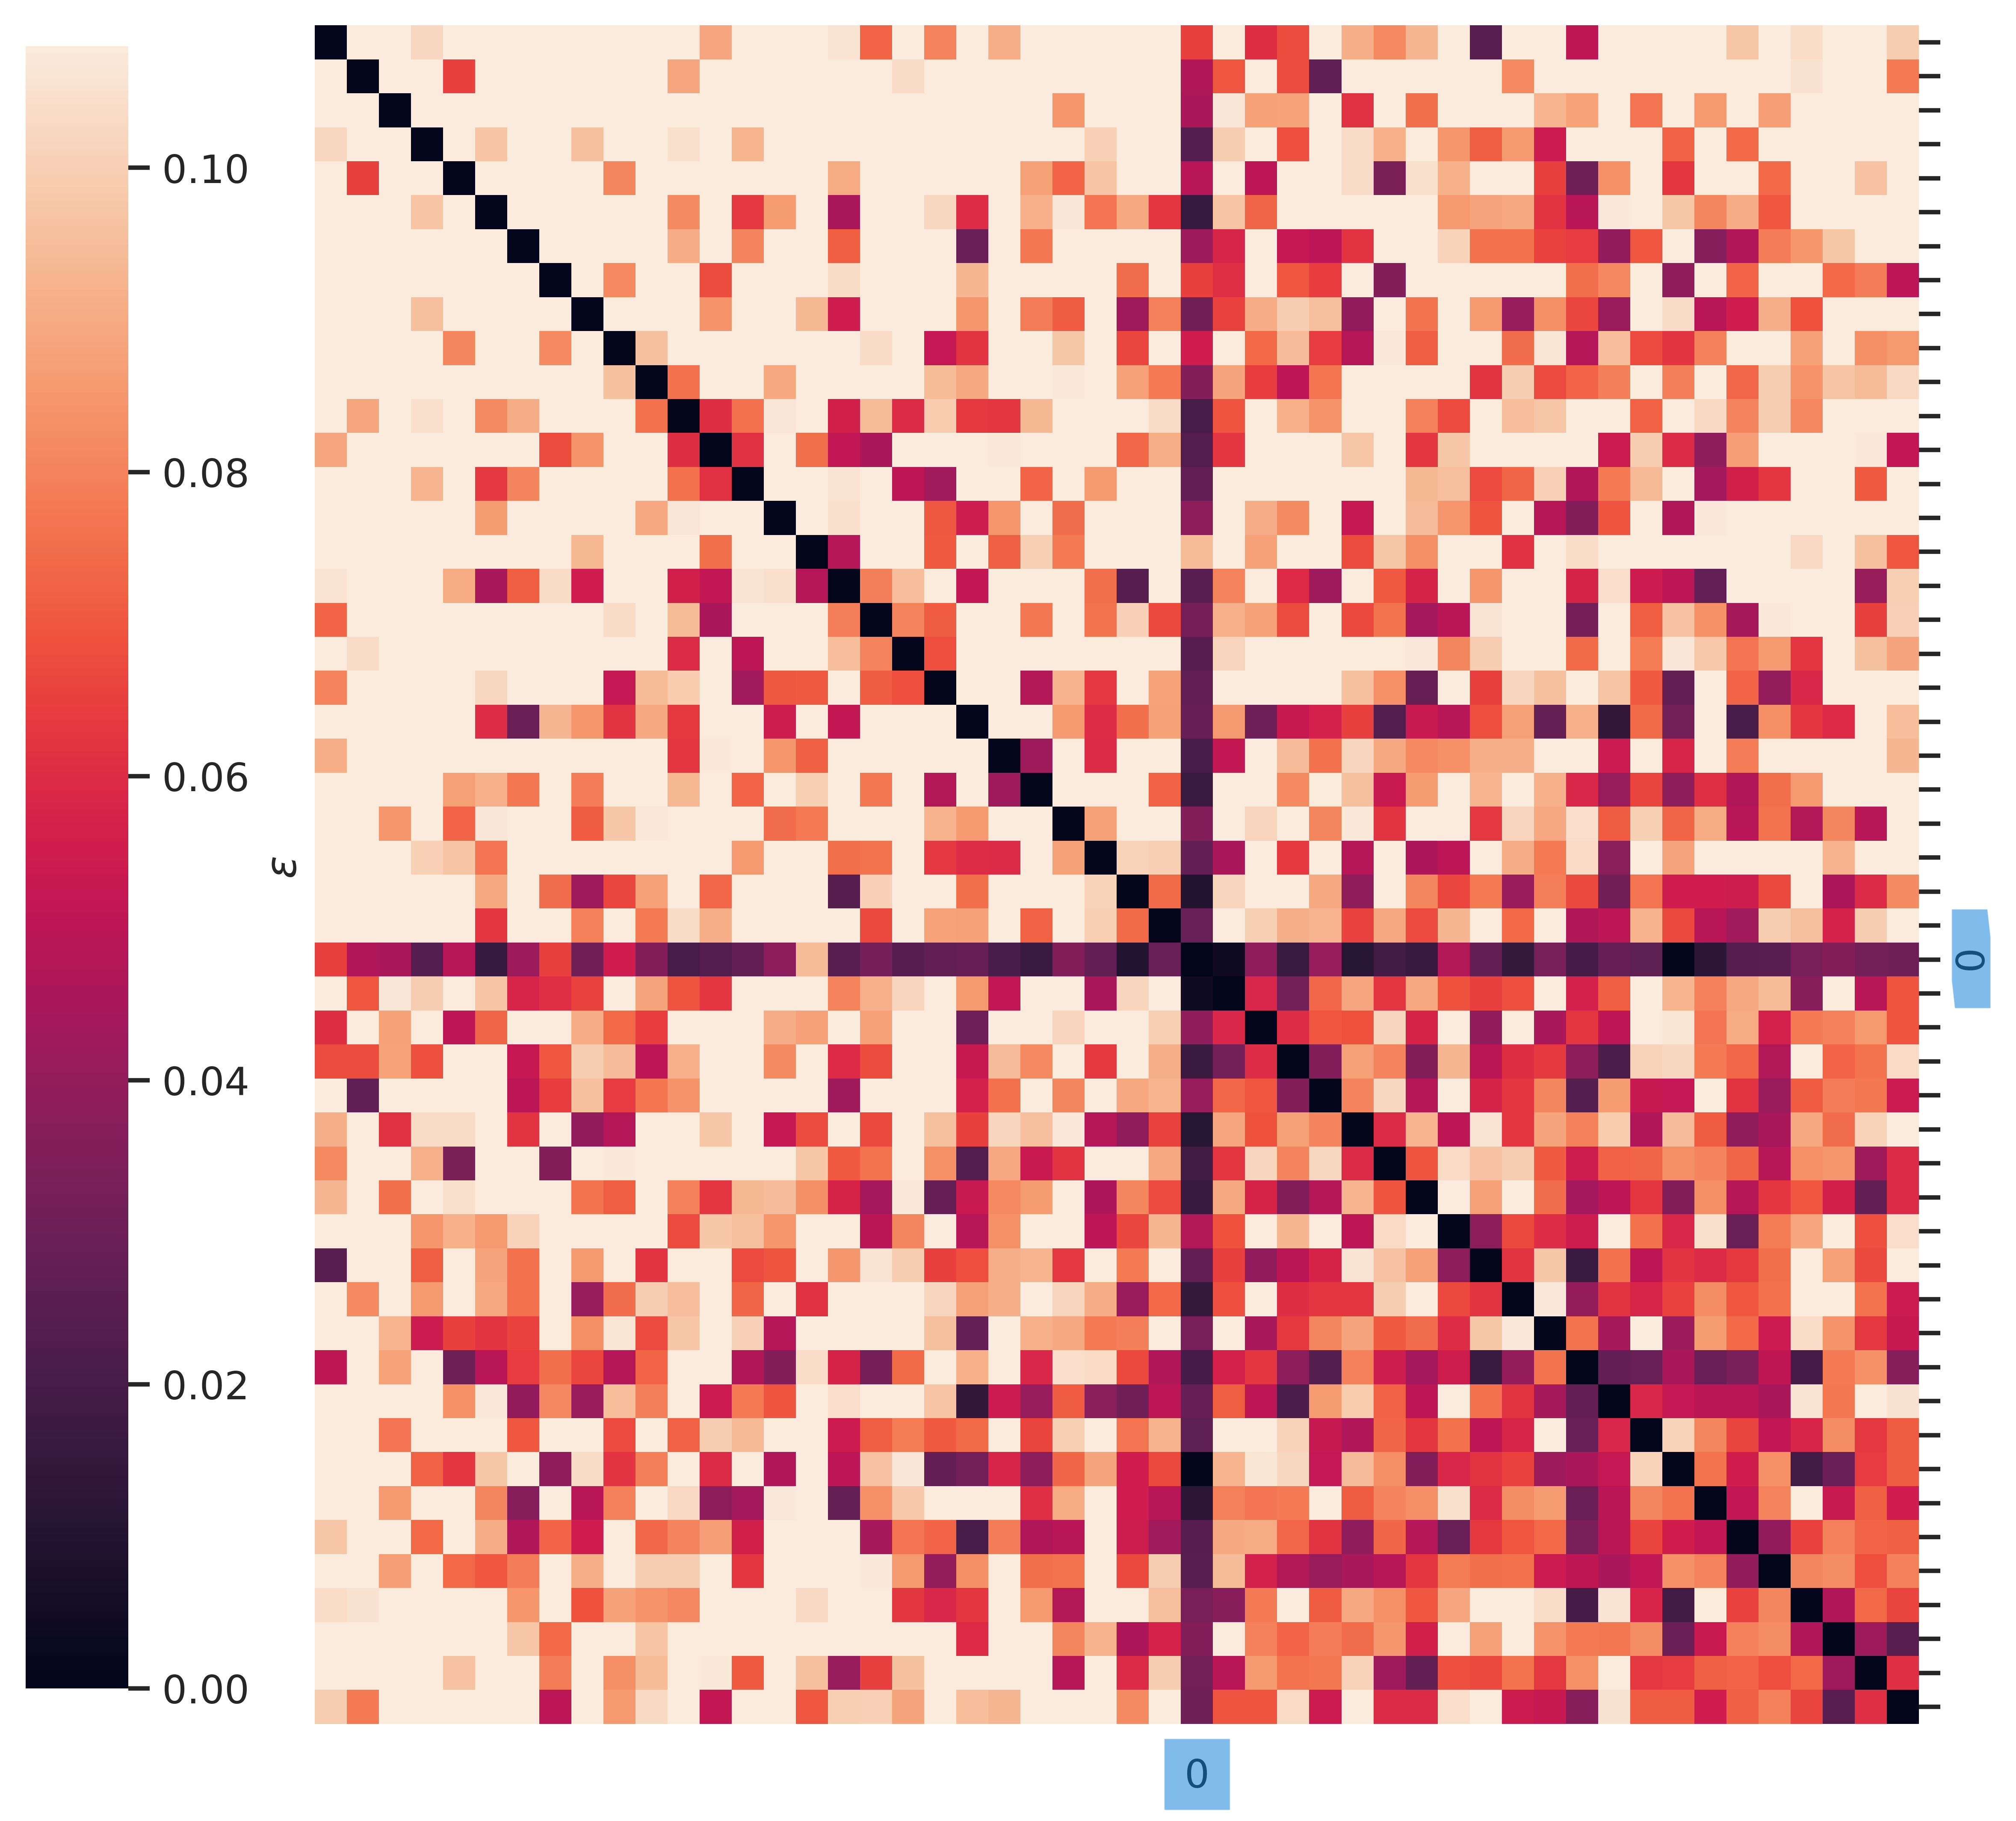
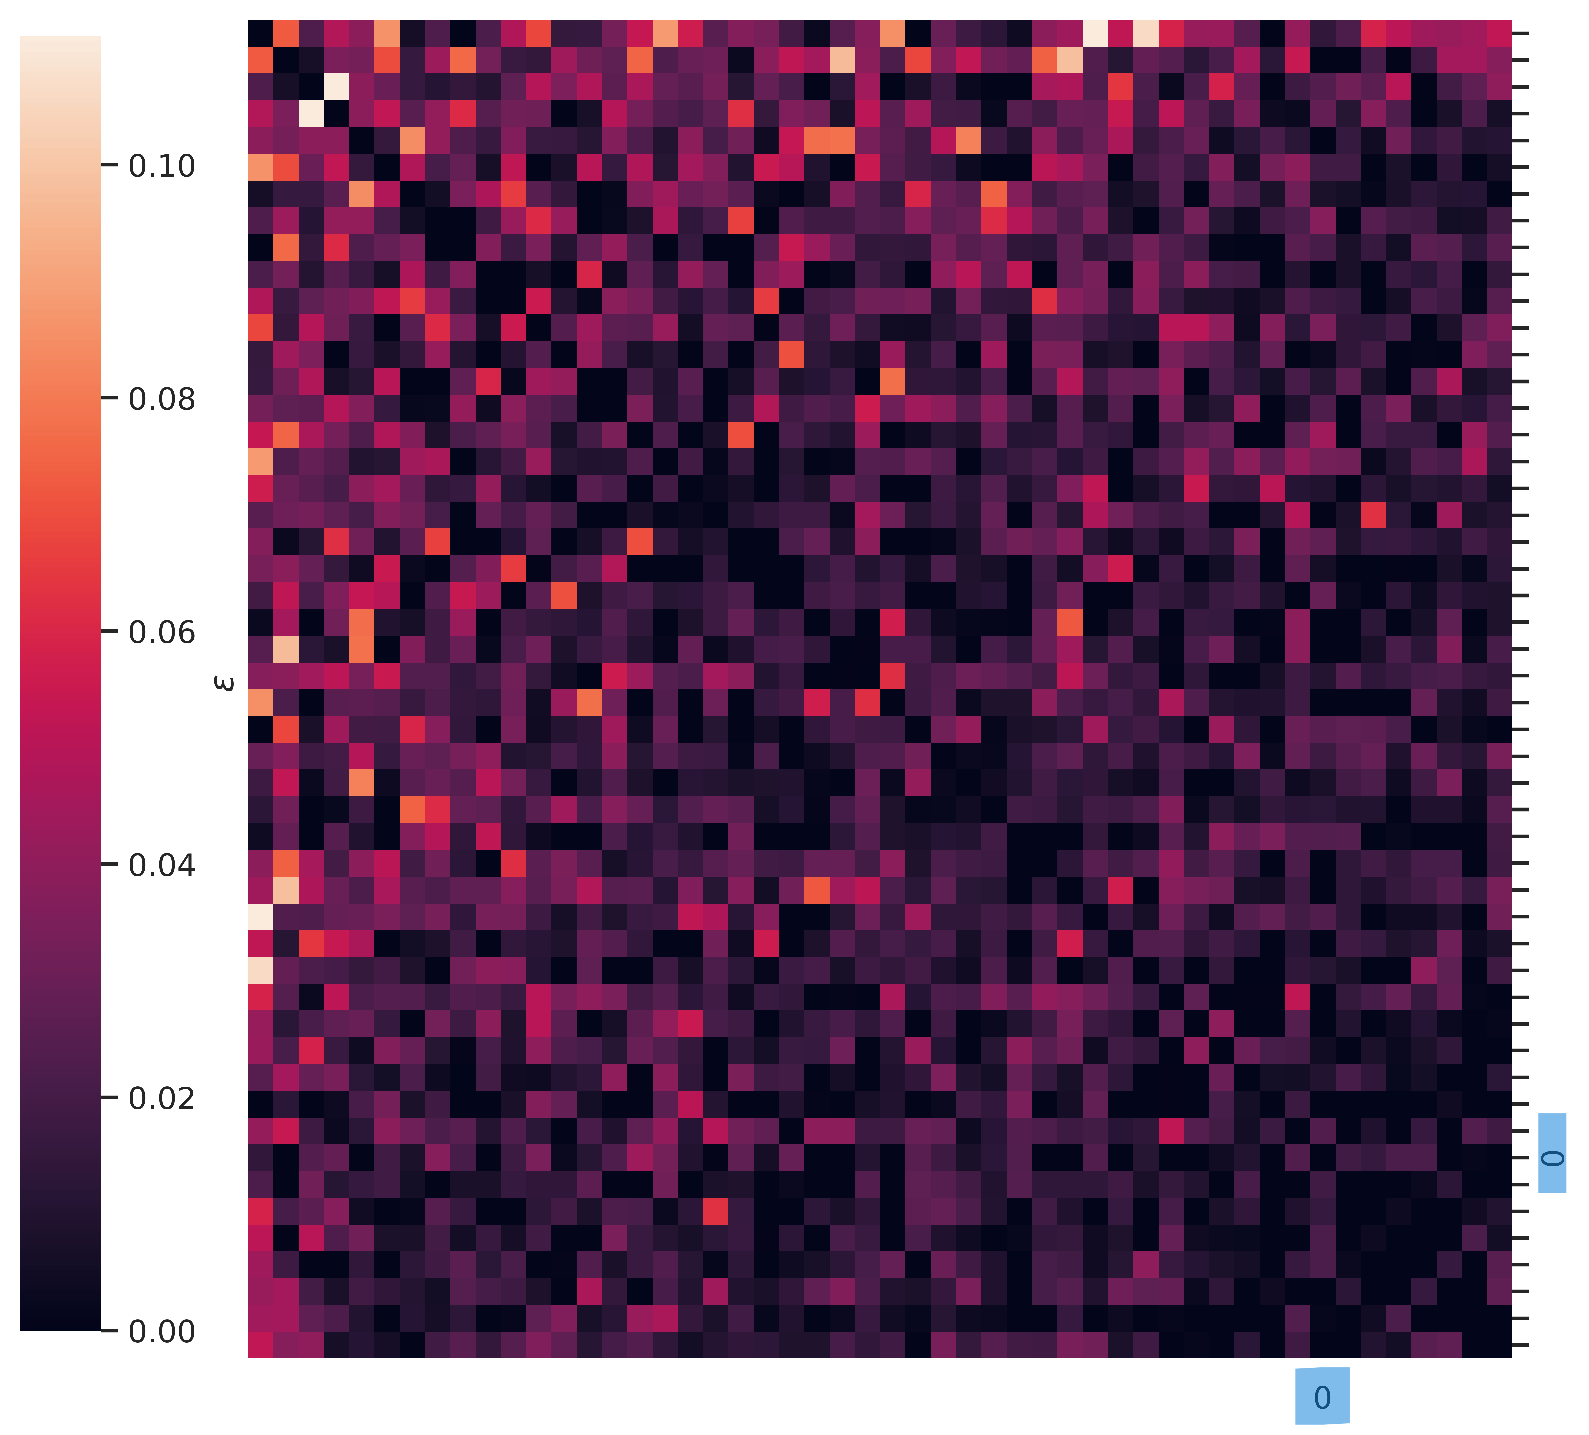
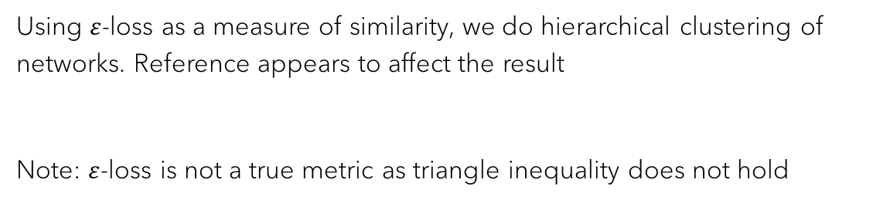
Are there clusters of MNIST networks that are LMC with each other and not others?
Width: 4
Width: 64
Width: 512
Using $ε$-loss as a measure of similarity, we do hierarchical clustering of networks. Reference appears to affect the result
Note: $ε$-loss is not a true metric as triangle inequality does not hold

Slide 25
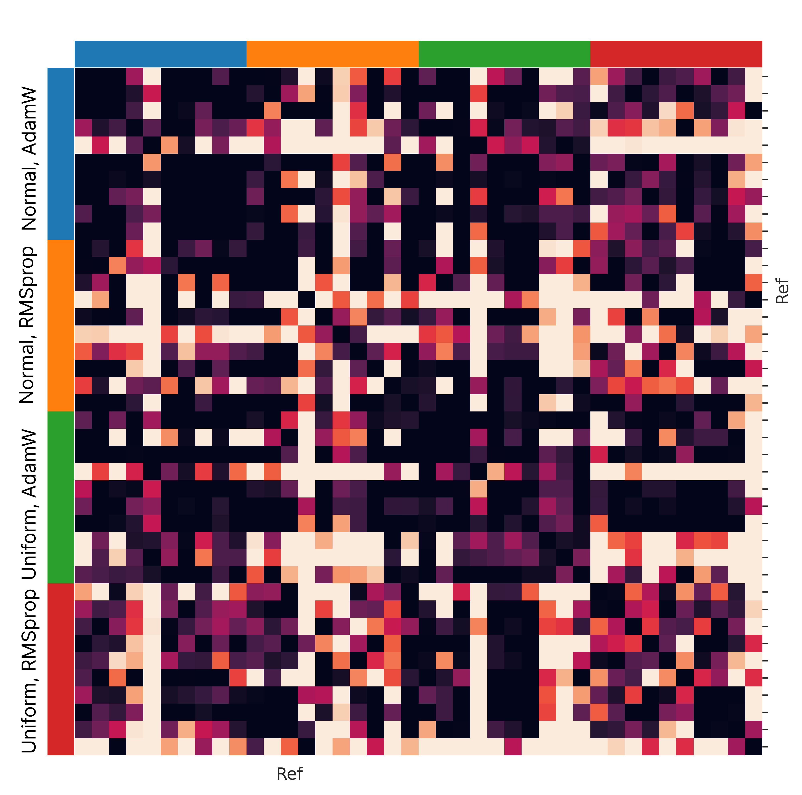
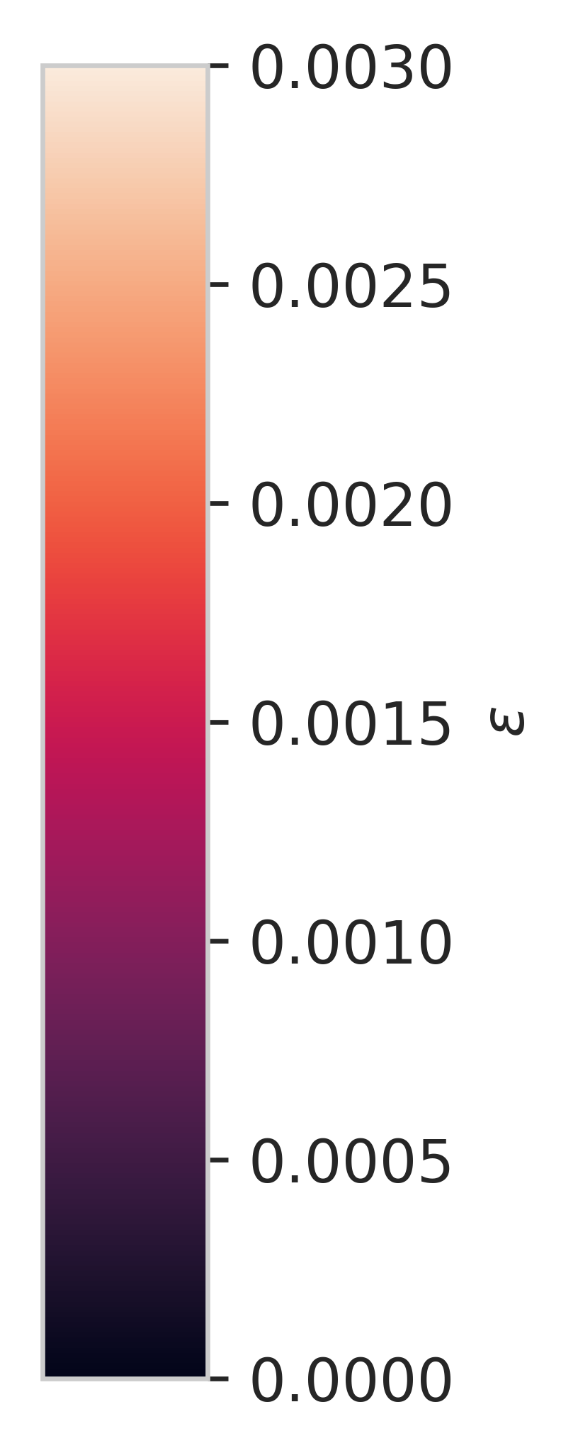
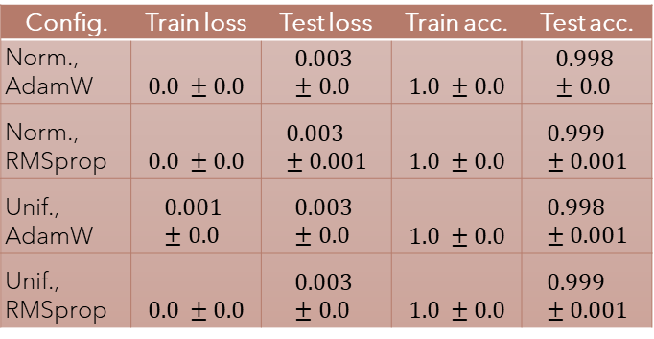
How robust are results to initialization & optimizer?
RMSprop networks on Moons appear to be less connected
Config. | Train loss | Test loss | Train acc. | Test acc.
Norm., AdamW | $$0.0 ±0.0$$ | $$0.003 ±0.0$$ | $$1.0 ±0.0$$ | $$0.998 ±0.0$$
Norm., RMSprop | $$0.0 ±0.0$$ | $$0.003 ±0.001$$ | $$1.0 ±0.0$$ | $$0.999 ±0.001$$
Unif., AdamW | $$0.001 ±0.0$$ | $$0.003 ±0.0$$ | $$1.0 ±0.0$$ | $$0.998 ±0.001$$
Unif., RMSprop | $$0.0 ±0.0$$ | $$0.003 ±0.0$$ | $$1.0 ±0.0$$ | $$0.999 ±0.001$$

Slide 26
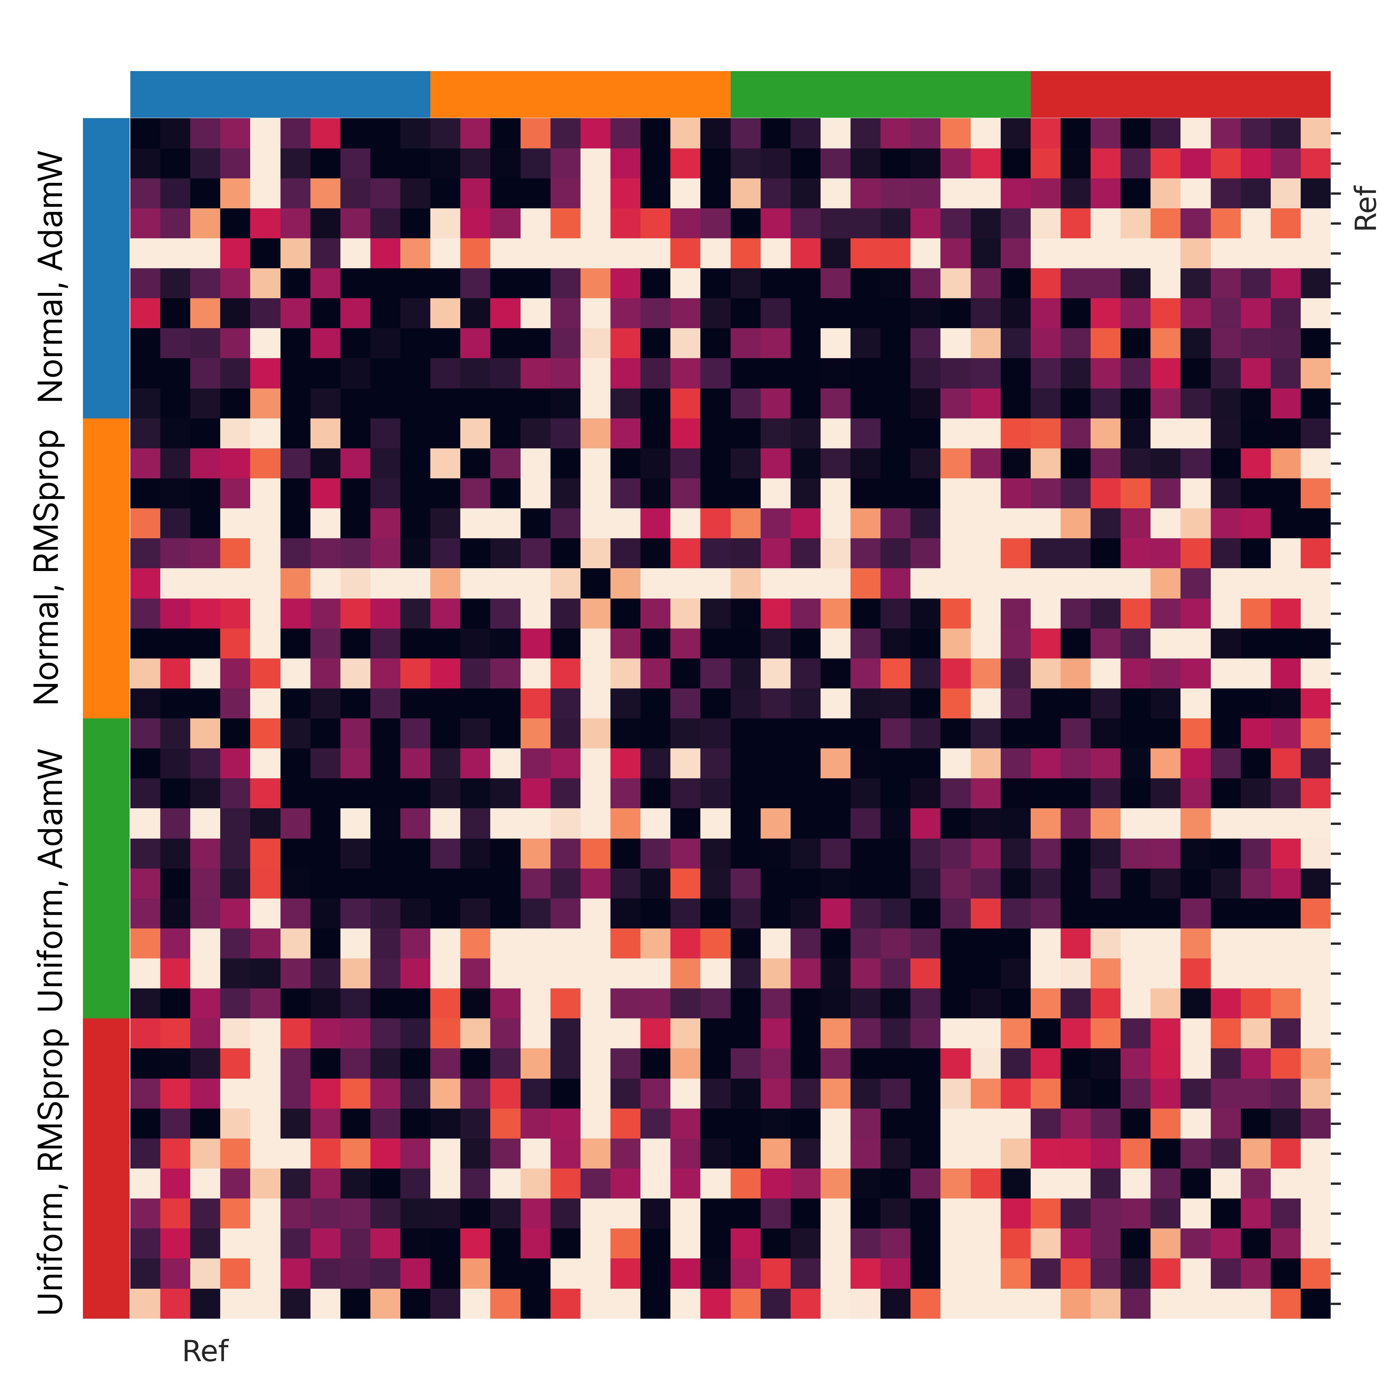
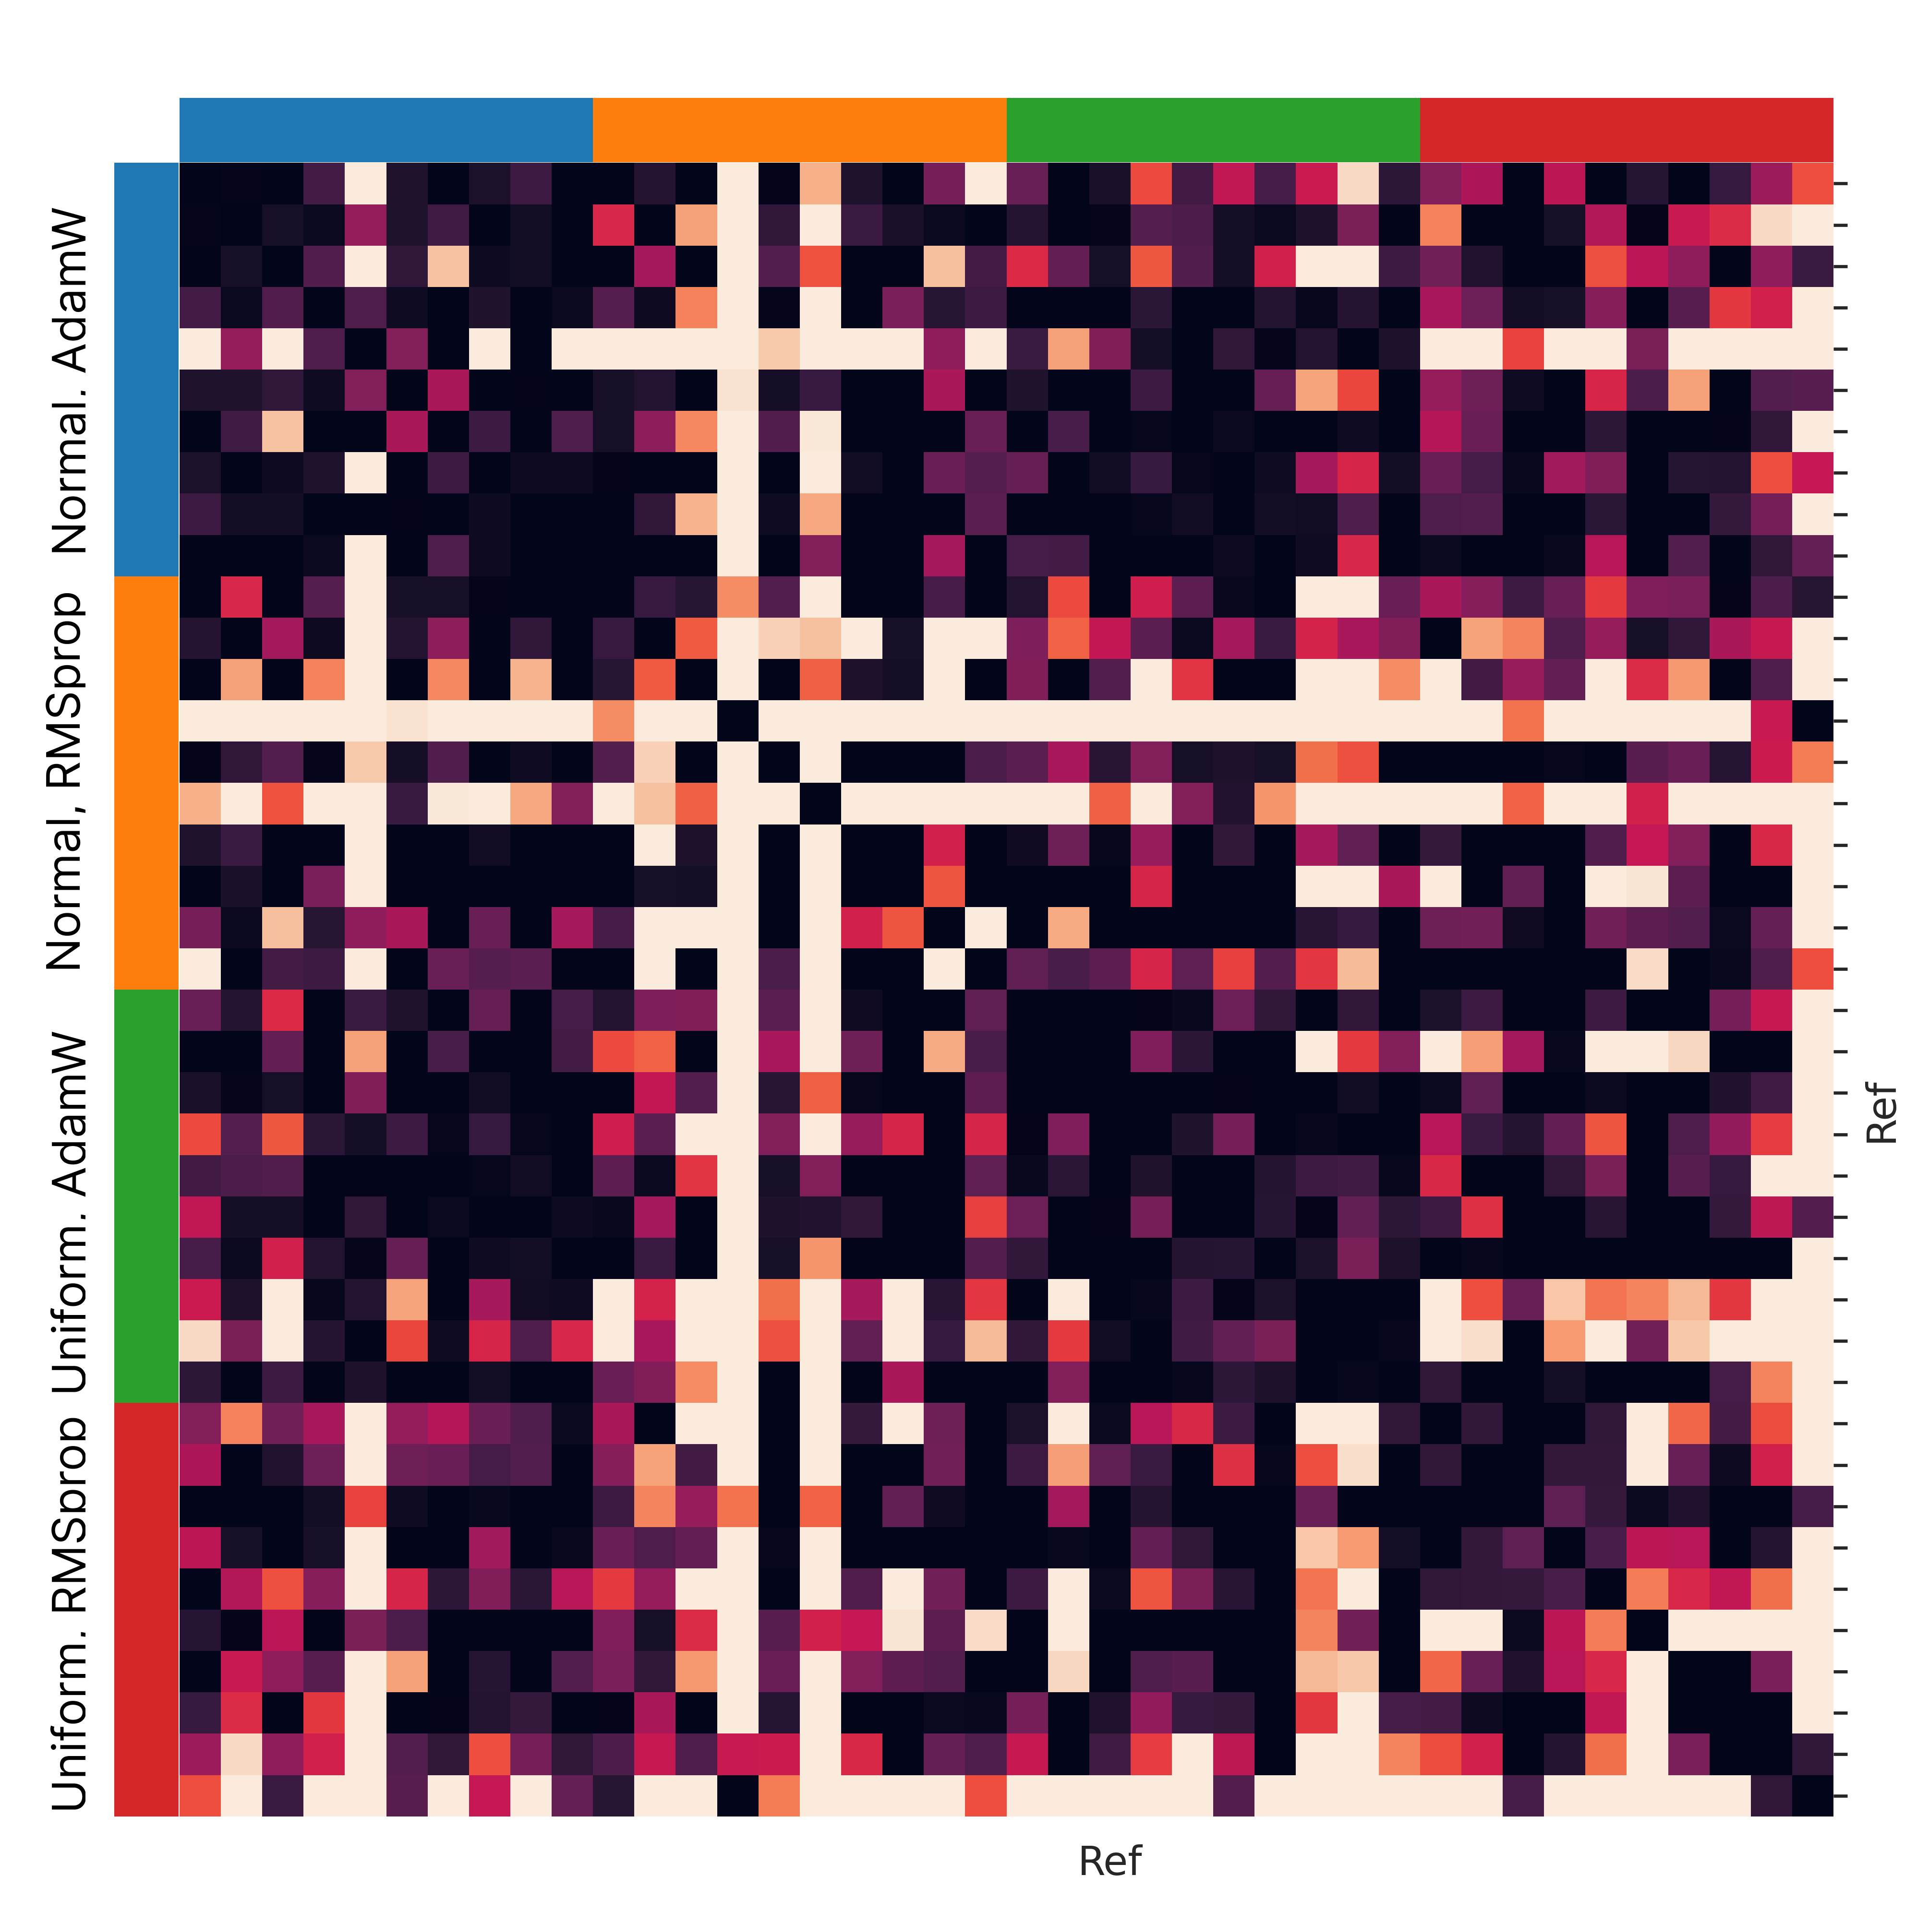


How robust are results to reference choice?
Reference choice impacts the results, but qualitatively similar
Normal, AdamW
Uniform, AdamW
Uniform, RMSprop
Pairwise

Slide 27



How robust are results to data complexity?
Ref: SGD
Ref: RMSprop
4-layer fully connected networks trained on CIFAR 10

Slide 28

Analyzing SWA
Starting with trained MNIST network, we run for 20 more epochs, and collect weights at end of each epoch as samples.
The loss along pairs of these samples are shown for different hidden layer widths.
SWA works as the samples are implicitly permutation aligned

Slide 29
Closing Remarks

